Slide 1
Deep Learning for Sequence Processing
Lori Levin, David Mortensen and Suyash Chavan
March 16, 2023
Language Technologies Institute

Slide 2
Learning Objectives
At the end of this lecture, students should be able to:
Describe Simple RNNs, Stacked RNNs, Bidirectional RNNs, and LSTMs
Understand what properties of language and what NLP tasks require these models
Apply Encoder-Decoder models to tasks like machine translation.
Describe attention mechanisms as they apply to LSTMs and Transformers
Apply Transformers to sequence-modeling tasks

Slide 3
Overview
We will discuss three classes of models in this lecture: RNNs, LSTMs, and Transformers.
 | Variable-Length Input | Recurrence | Self-Attention
FFNN | ❌ | ❌ | ❌
Simple RNN | ✓ | ✓ | ❌
LSTM | ✓ | ✓ | ❌
Transformer | ✓ | ❌ | ✓

Slide 4
Review: why do we need all of these different neural models?
Long distance dependencies in natural language
When left context isn’t enough

Slide 5
Long distance dependencies
Something in a sentence depends on something that is more than a few words away
problem for n-gram language models
problem for vanishing influence of prior context

Slide 6
Long distance: adding a modifier to the subject makes it far away from the verb it agrees with
The teachers is/are happy.
The teachers who spoke to the student about the project is/are happy.
The teachers in the large classroom in Gates-Hillman is/are happy.

Slide 7
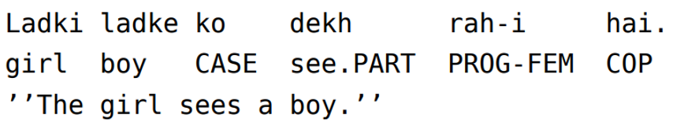
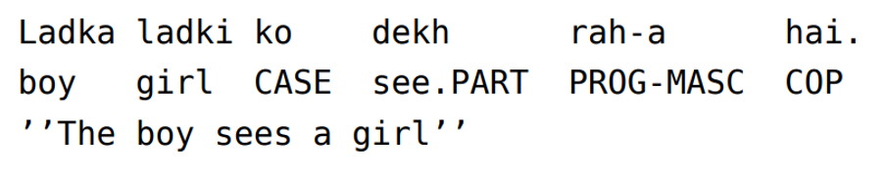
Verb-final languages: the subject is always far from the verb
Hindi, written in Roman characters.

Slide 8
Long distance: when there needs to be a “gap”
You wrote long stories about ∅/dragons last year.
What did you write long stories about ∅/dragons last year?
These salespeople are happy to try very hard to please ∅/customers.
These salespeople are easy to try very hard to please ∅/customers.

Slide 9
Long distance: when there needs to be a “gap”
Consider the following sentences
You wrote long stories about _____ last year.
You wrote long stories about ∅ last year.
You wrote long stories about dragons last year.

Slide 10
Long distance: when there needs to be a “gap”
Consider the following sentences
You wrote long stories about _____ last year.
You wrote long stories about ∅ last year.
You wrote long stories about dragons last year.
What did you write long stories about _____ last year?
What did you write long stories about ∅ last year?
What did you write long stories about dragons last year?

Slide 11
Long distance: negative polarity words need to be in a question or negated sentence
They said that they were able to meet anybody.
Did they say that they were able to meet anybody?
They didn’t say that they were able to meet anybody.

Slide 12

Left context is not enough: resolving ambiguity
[The old man] is rowing.
“man” is a noun
The old [man the boats.]
“man” is a verb
I seeded the field.
put seeds on
I seeded the watermelon.
took seeds out
I know that.
“that” is a pronoun
I know that student.
“that” is a determiner
I know that you yawned.
“that” is a complementizer (a word that introduces an embedded sentence).

Slide 13
LSTMs and Bi-LSTMs

Slide 14
Comparing Simple RNNs to LSTMs
Simple RNN
Long Short-Term Memory (LSTM)
Recurrent
Hidden state at time t is a function of the input and the hidden state at time t-1
Input is combined with previous hidden state using element-wise addition.
Severe vanishing gradient problem
Recurrent
Hidden state at t is a function of input, hidden state at t-1 and context vector
Input is combined with preceding hidden state and context vector using articulated gating mechanism
Reduced vanishing gradient problem

Slide 15
Go over “long-distance dependencies” again
Do we have evidence that LSTMS so better than RNNs at long distance dependencies?

Slide 16
LSTMs Add Cells
Three gates in each cell:
Input gate
Output gate
Forget gate
These control the flow of information used for prediction and make LSTMs better than RNNs at handling the kinds of long-distance patterns we discussed previously.

Slide 17
LSTMs Use a Context Layer
In parallel with the hidden layer h, LSTMs have a context layer C (of context vectors C₁,...,C_{n}) that carries a certain kind of information across timesteps.
The context vector indicates what gets passed on about the current input and how much the current input will continue to contribute to updating the hidden state.

Slide 18
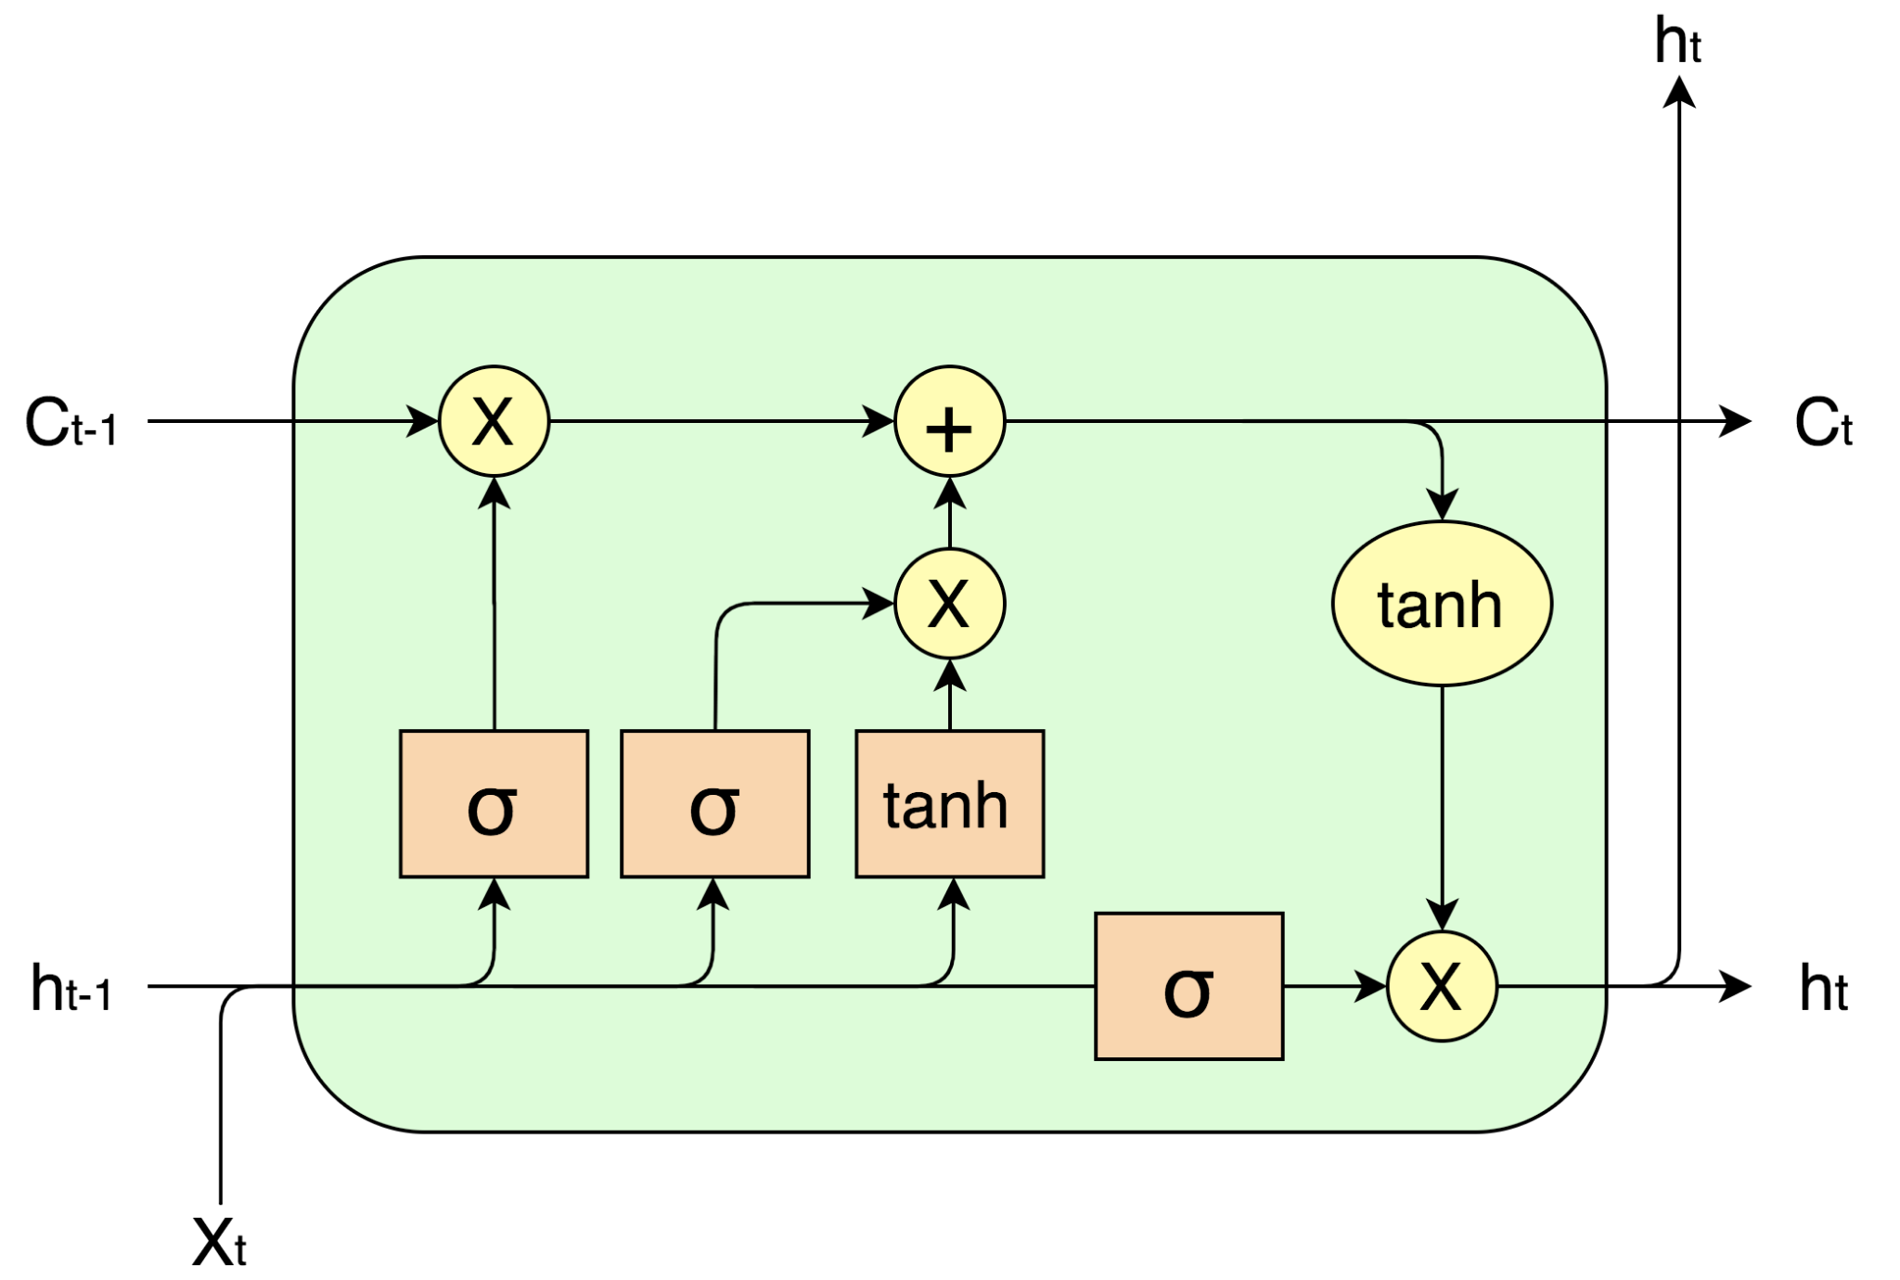
LSTMs Have an Articulated Internal Structure
Operations:
+ is element-wise addition
× is element-wise multiplication
Non-linear functions
σ is sigmoid
tanh is hyperbolic tangent
Vectors
C_{t-1} is the context vector
h_{t-1} and h_{t} are the hidden layer at the previous and current timestep
X_{t} is the input (at the current timestep)
forget gate f
input gate i
output gate o

Slide 19
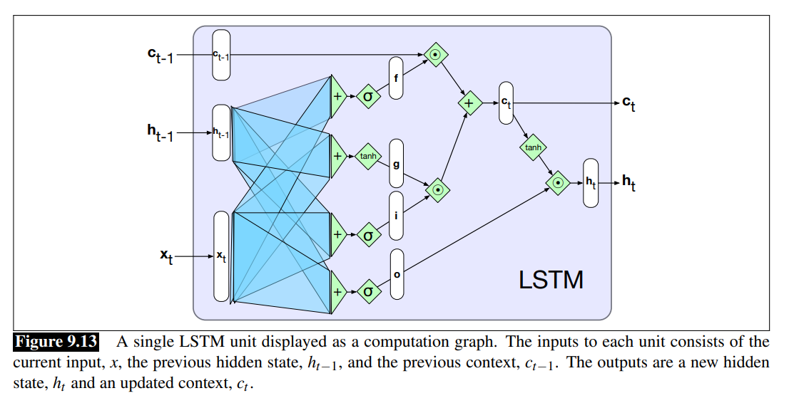
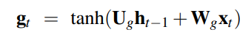
Do the usual RNN thing with the current input and the hidden state for the previous time step, and their weight matrices
U is a weight matrix that is multiplied with the hidden layer of the previous time step.
W is a weight matrix that is multiplied by the current input.
Use tanh as the activation function.
The result is called g in the diagram.

Slide 20
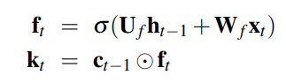
How to forget
U is a weight matrix that is multiplied with the hidden layer of the previous time step.
W is a weight matrix that is multiplied by the current input.
Use sigmoid as the activation function in order to push outputs toward 0 or 1.
This results in a “mask”, shown as f in the diagram.
Multiply the mask by the context vector from the previous time step, resulting in a vector k.
k

Slide 21
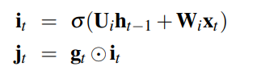
How to remember
U is a weight matrix that is multiplied with the hidden layer of the previous time step.
W is a weight matrix that is multiplied by the current input.
Use sigmoid as the activation function.
The result is called i in the diagram.
Multiply i times g to get a vector j of things to remember.
k
j

Slide 22
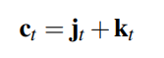
How to make the context vector for timestep t
k
j

Slide 23
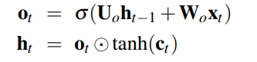
How to make the output gate
The output gate is used to decide what information is required for the hidden state.
The context vector preserves information for future decisions.
Apply tanh to the context vector, and then multiply that by the output gate to get the hidden state.
Output the hidden state and the context for use in the next timestep.
k
j

Slide 24
Deep Learning Architectures for Sequence Modelling

Slide 25
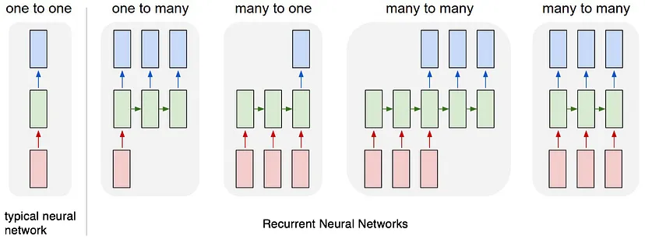
We have seen regular Neural Networks ….

Slide 26
… and Regular RNNs

Slide 27
But these can be modified for many use-cases

Slide 28
Encoder-Decoder (Sequence to Sequence) Models

Slide 29
Encoder-Decoder (Sequence to Sequence) Models in a Nutshell
Encoder-Decoder models take a sequence as input, encode it as a vector or other real-valued representation, and then decode it into another sequence.
Example—
Input: Ich bin auch ein Berliner [German]
[vector]
Output: I am also a Berliner [English] or
I am also a jelly doughnut* [English]
Originally, this was done with RNNs (then LSTMs)
*A Berliner is not exactly a jelly doughnut but a sweet pastry filled with jam and covered with powdered sugar.

Slide 30
Tasks Other than Machine Translation
Encoder-Decoder models can potentially be used for any task that involves converting one sequence/string into another:
Morphological analysis (coverts strings of characters into string of characters [lemmas] and sequences of morphological tags)
Summarization (coverts a sequence of words [the original document] into a shorter sequence of words [the summary])
Dialog (converts a sequence of words [the preceding turn] into another sequence of words [the following turn])
And so on…

Slide 31
An Overview of the Encoder-Decoder Model for MT
The following slides will show a high-level overview of Machine Translation using an RNN
At each time step, the RNN will consume an encoded word
The state, at that step, will be a function of the embedding of the word and the state at the preceding step
At the end of the input (the German sentence) the RNN is fed an <s> token—it’s showtime
The RNN then starts generating English outputs based on the preceding hidden state and the preceding output, until the end token </s> is reached

Slide 32
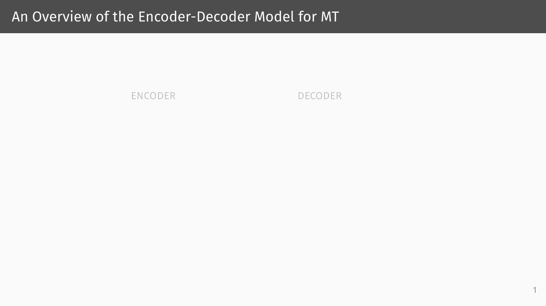

Slide 33
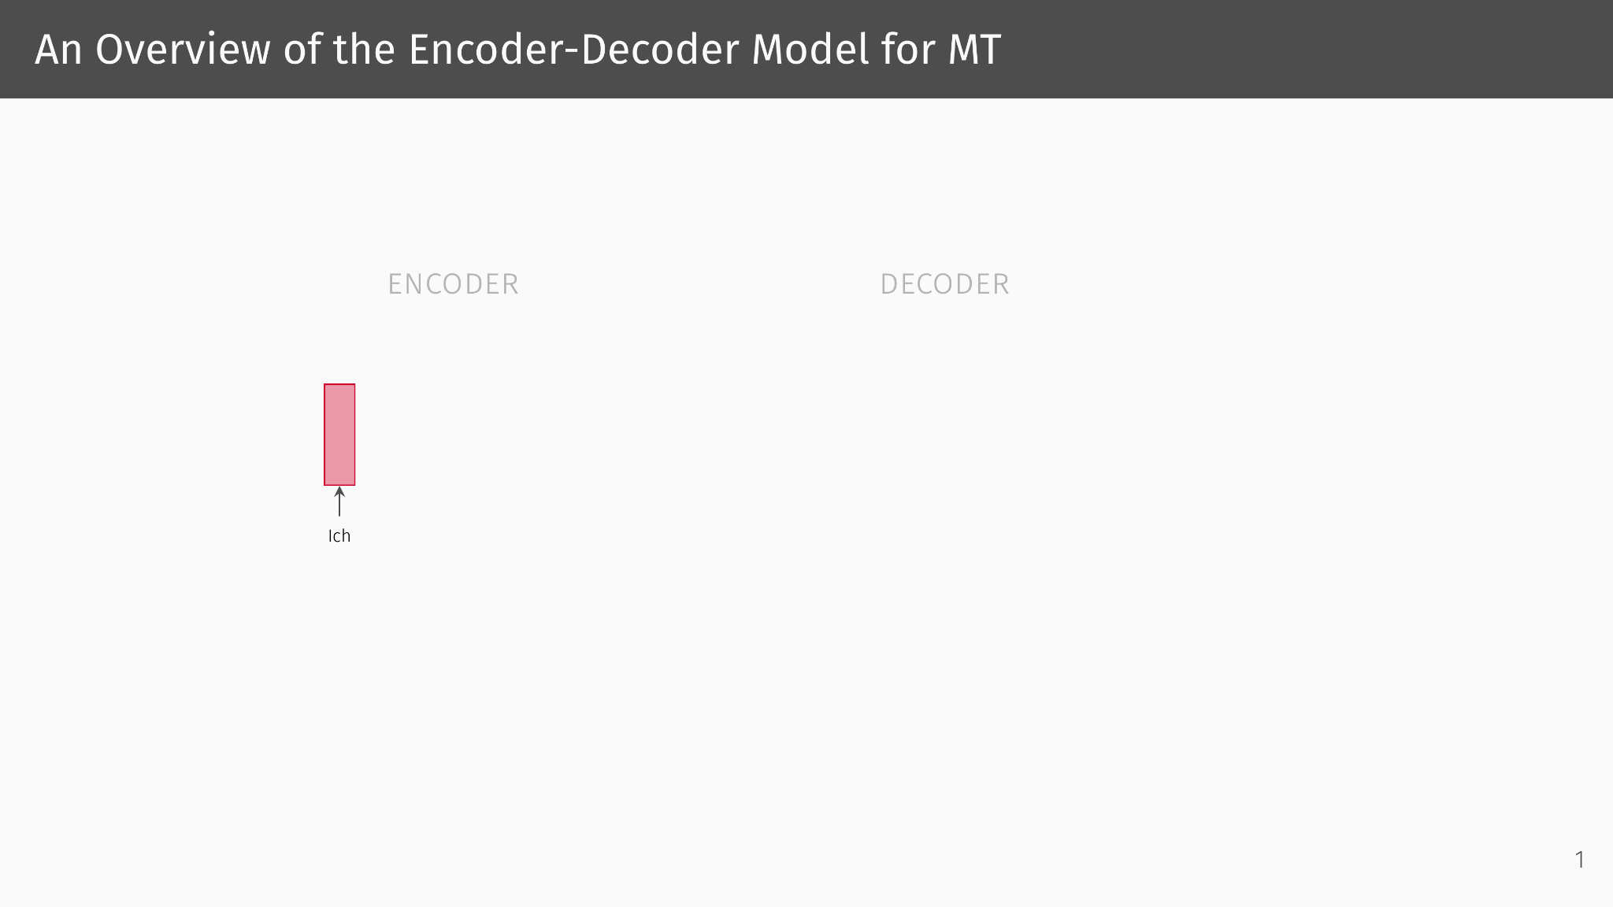

Slide 34
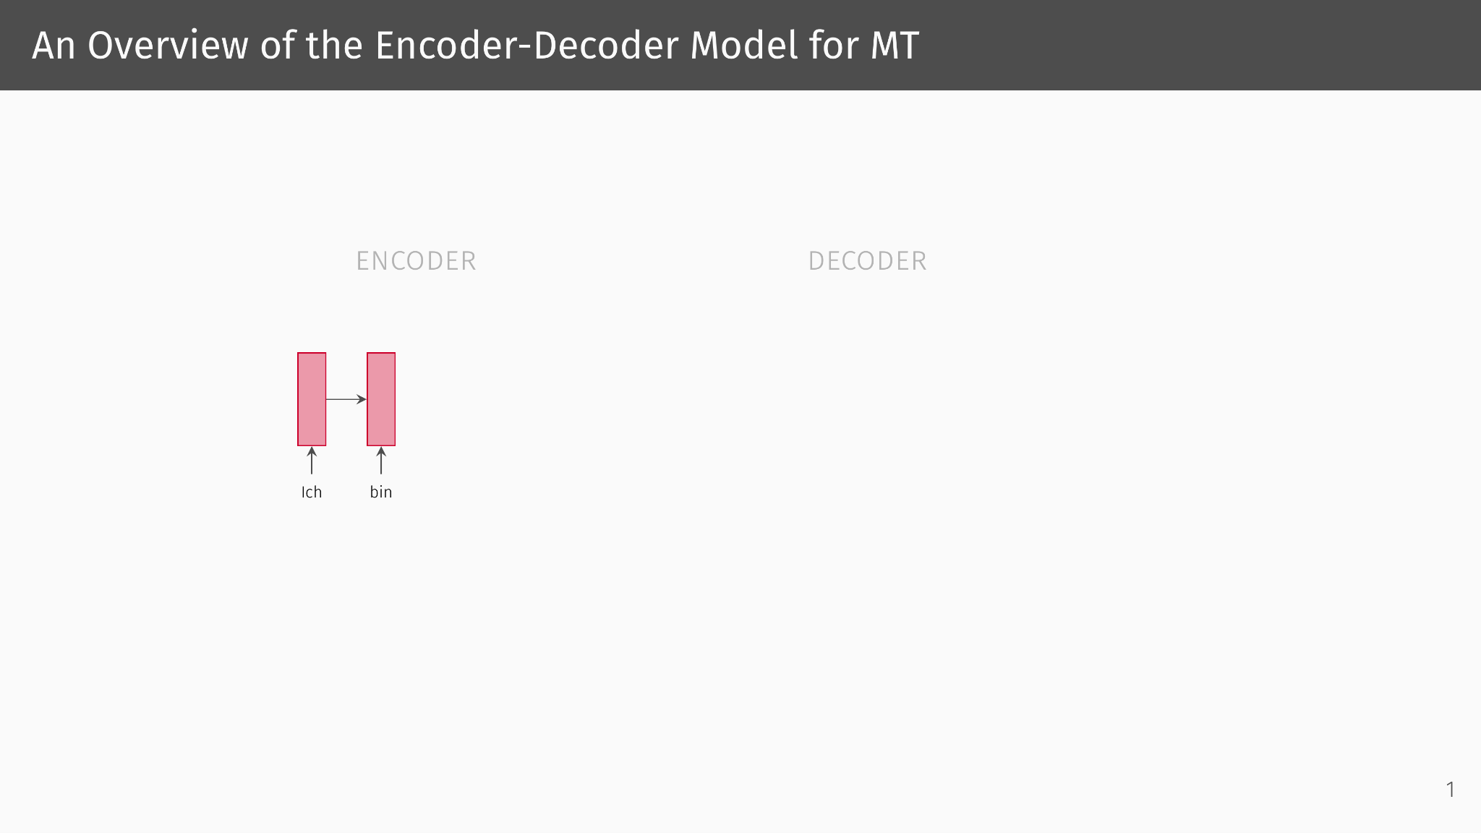

Slide 35
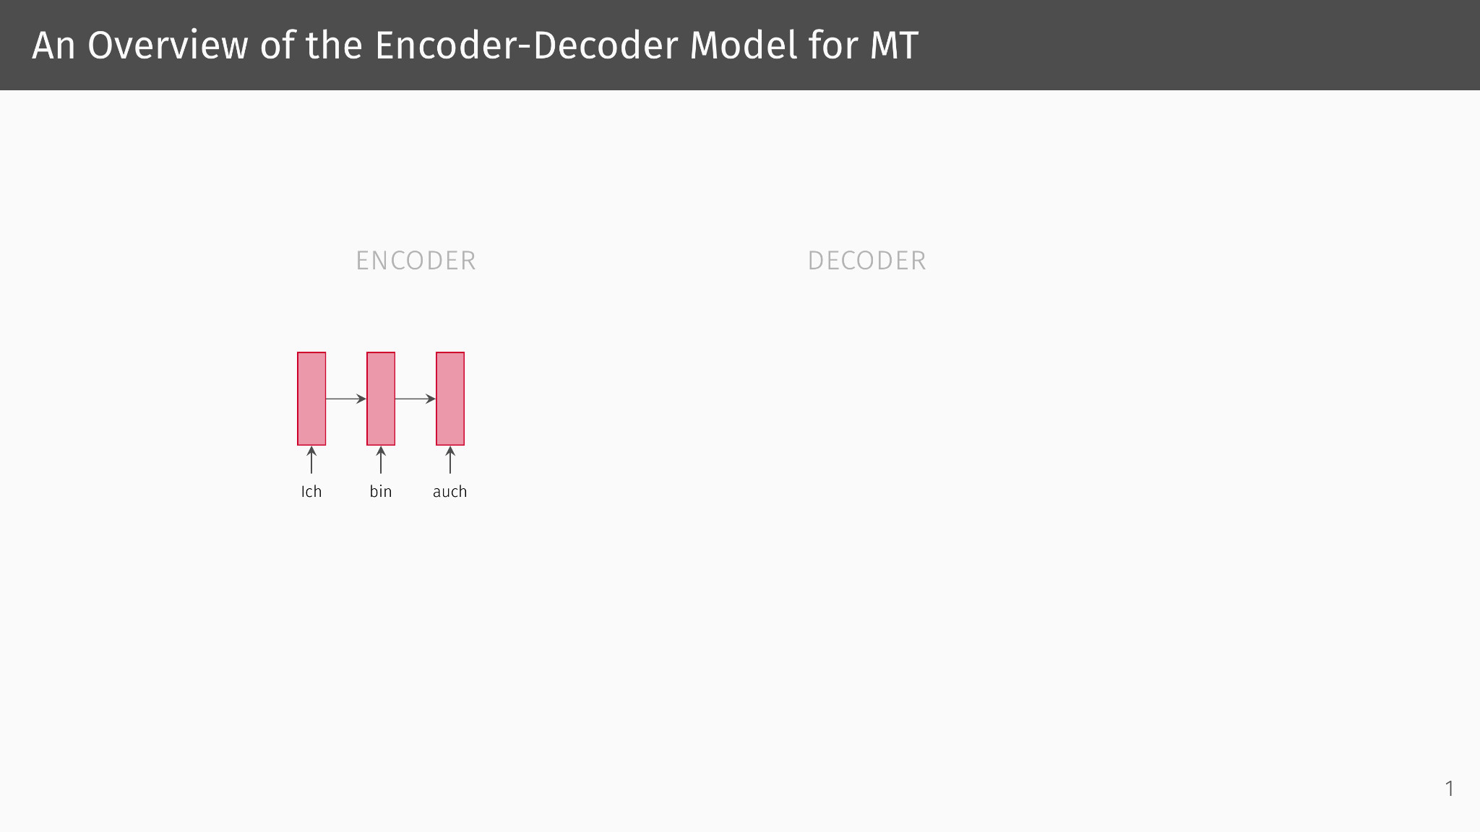

Slide 36
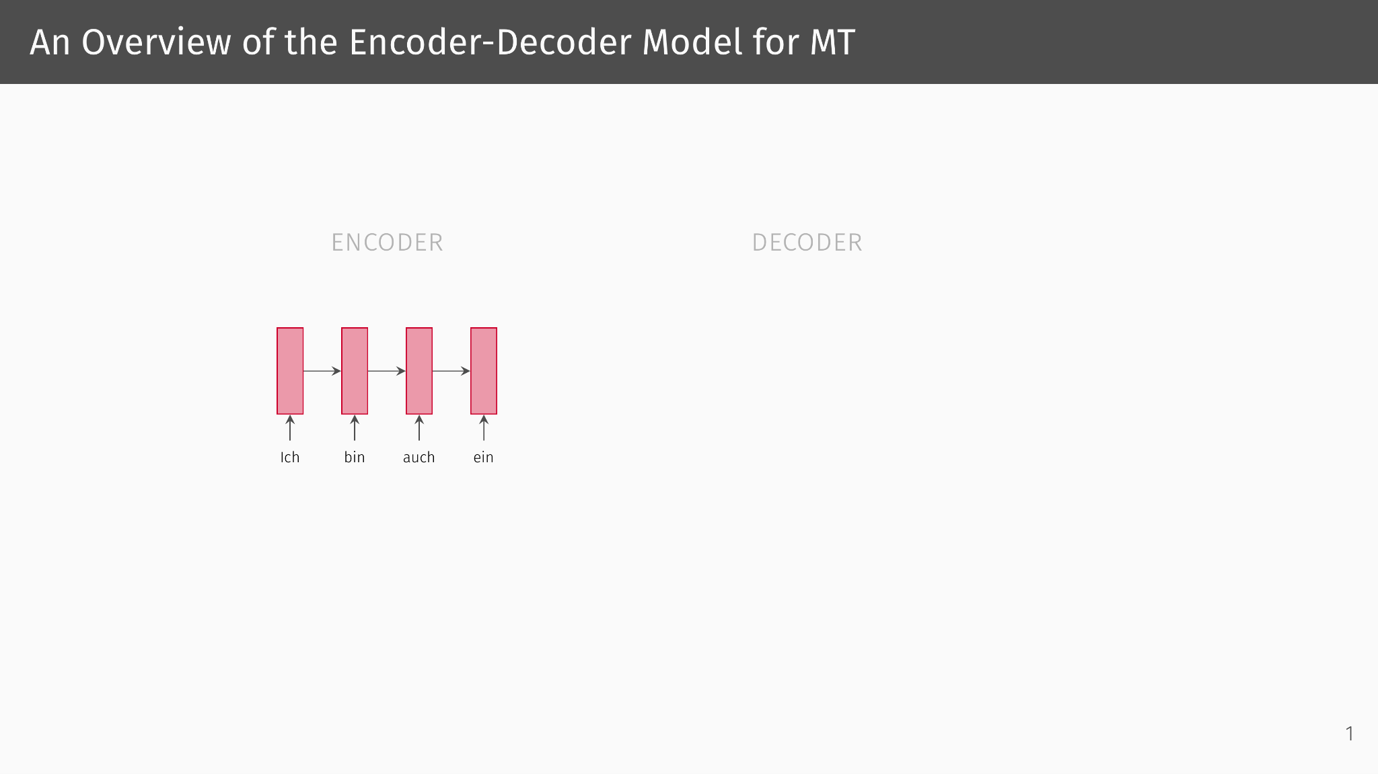

Slide 37
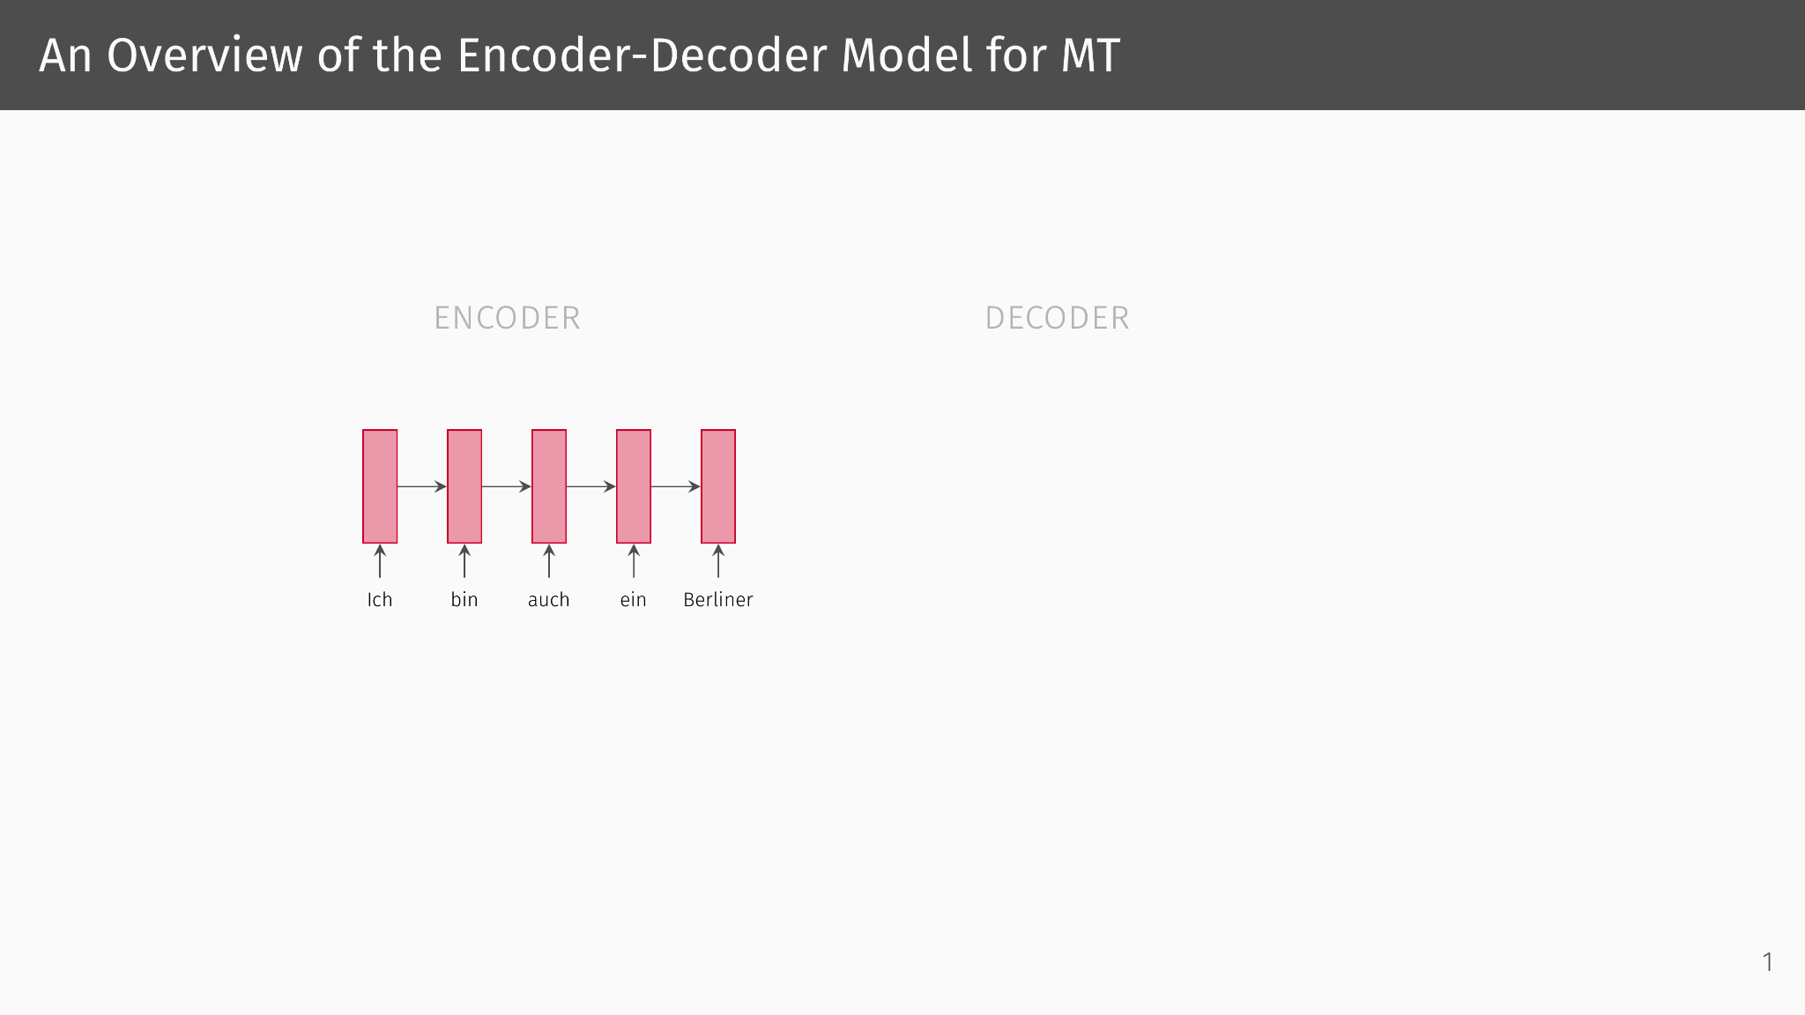

Slide 38
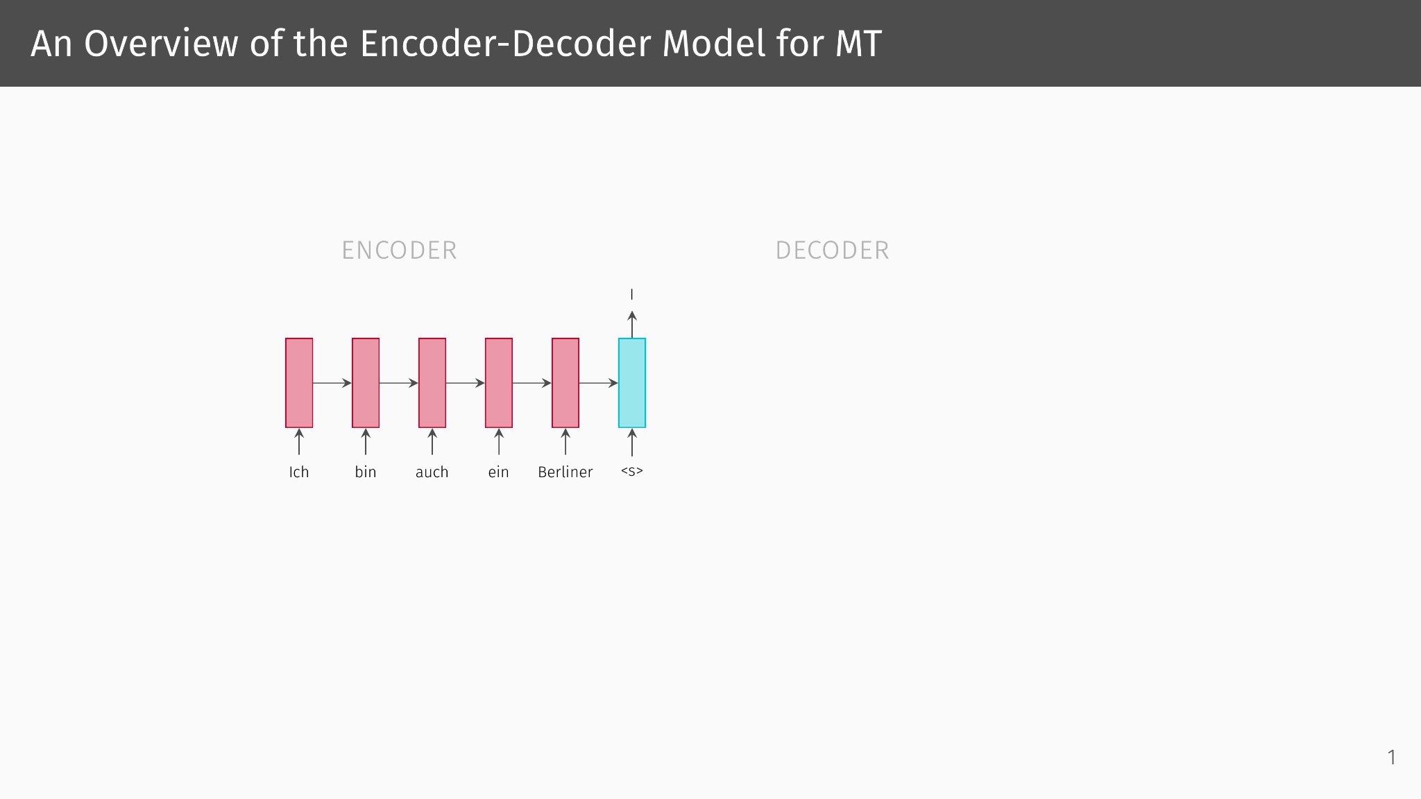

Slide 39
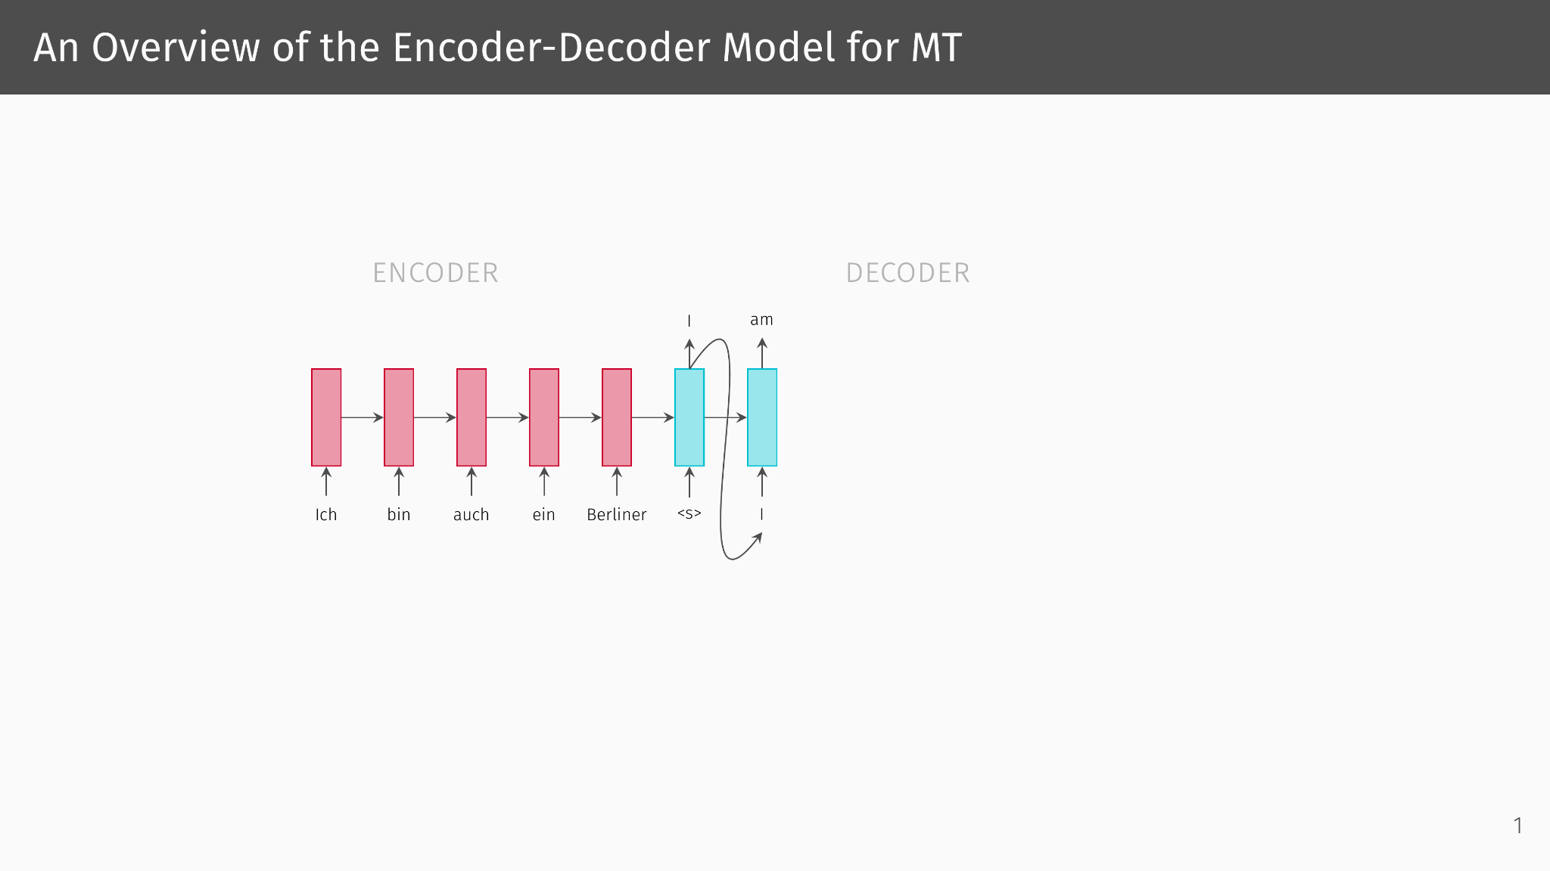

Slide 40
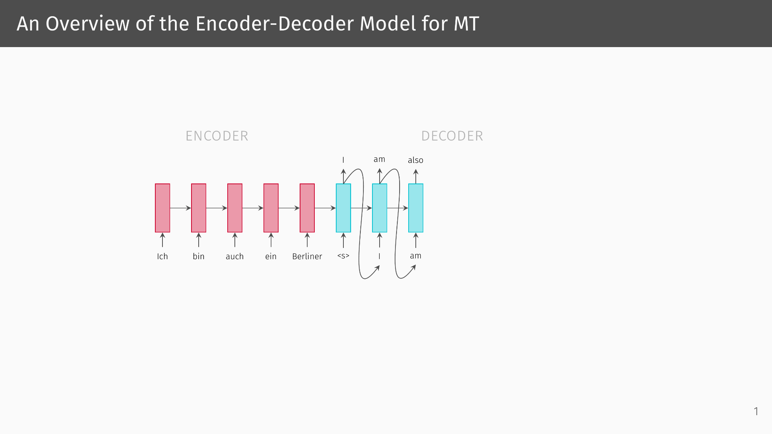

Slide 41
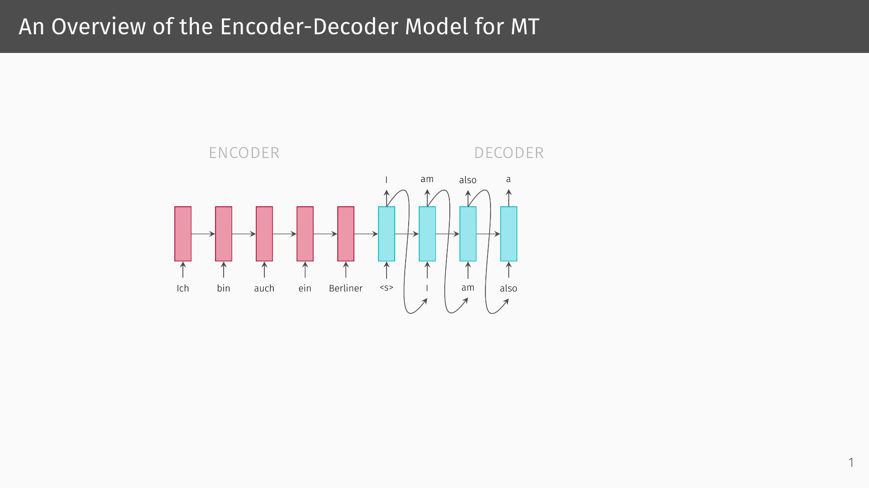

Slide 42
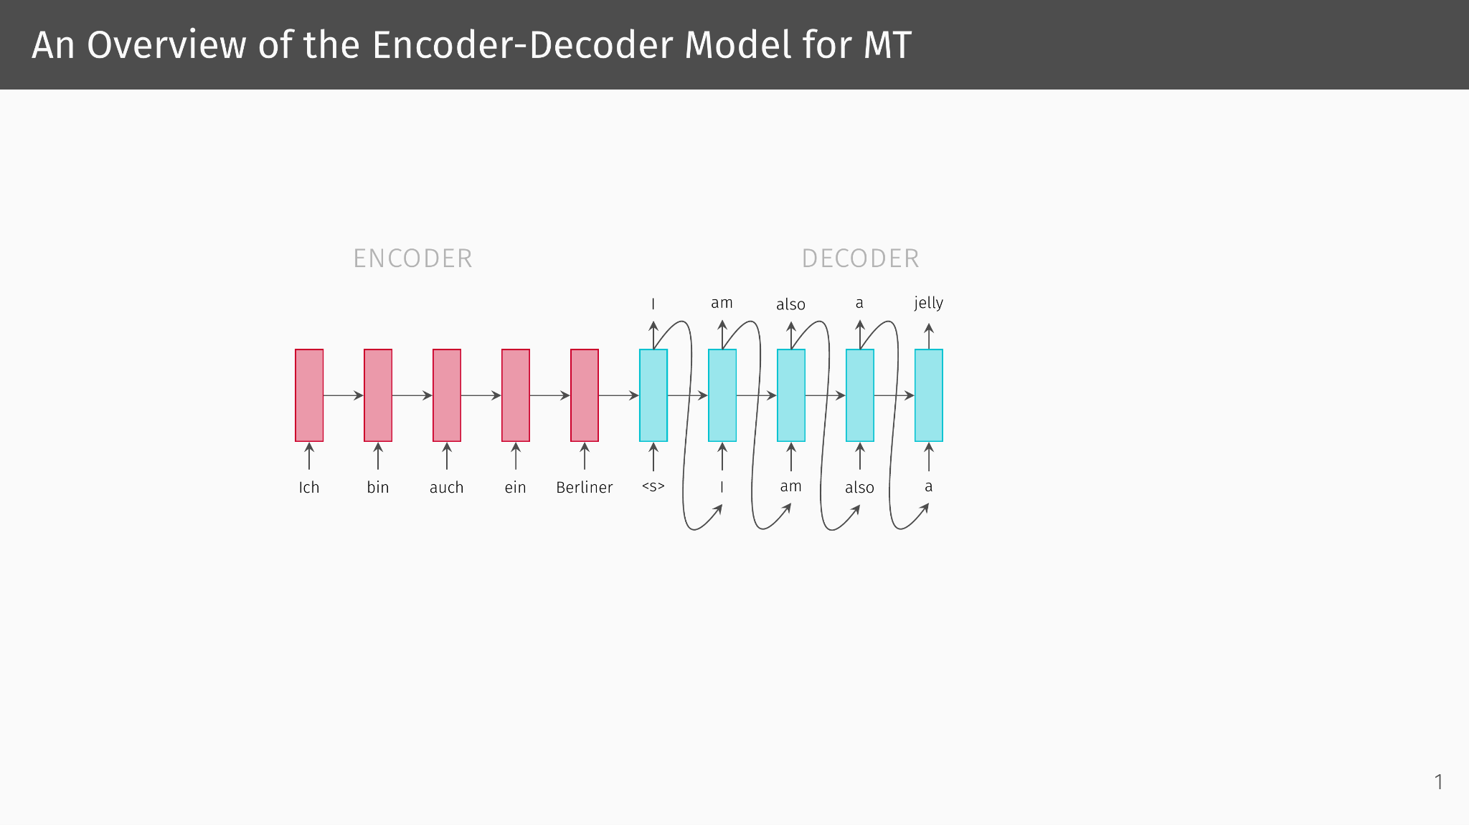

Slide 43
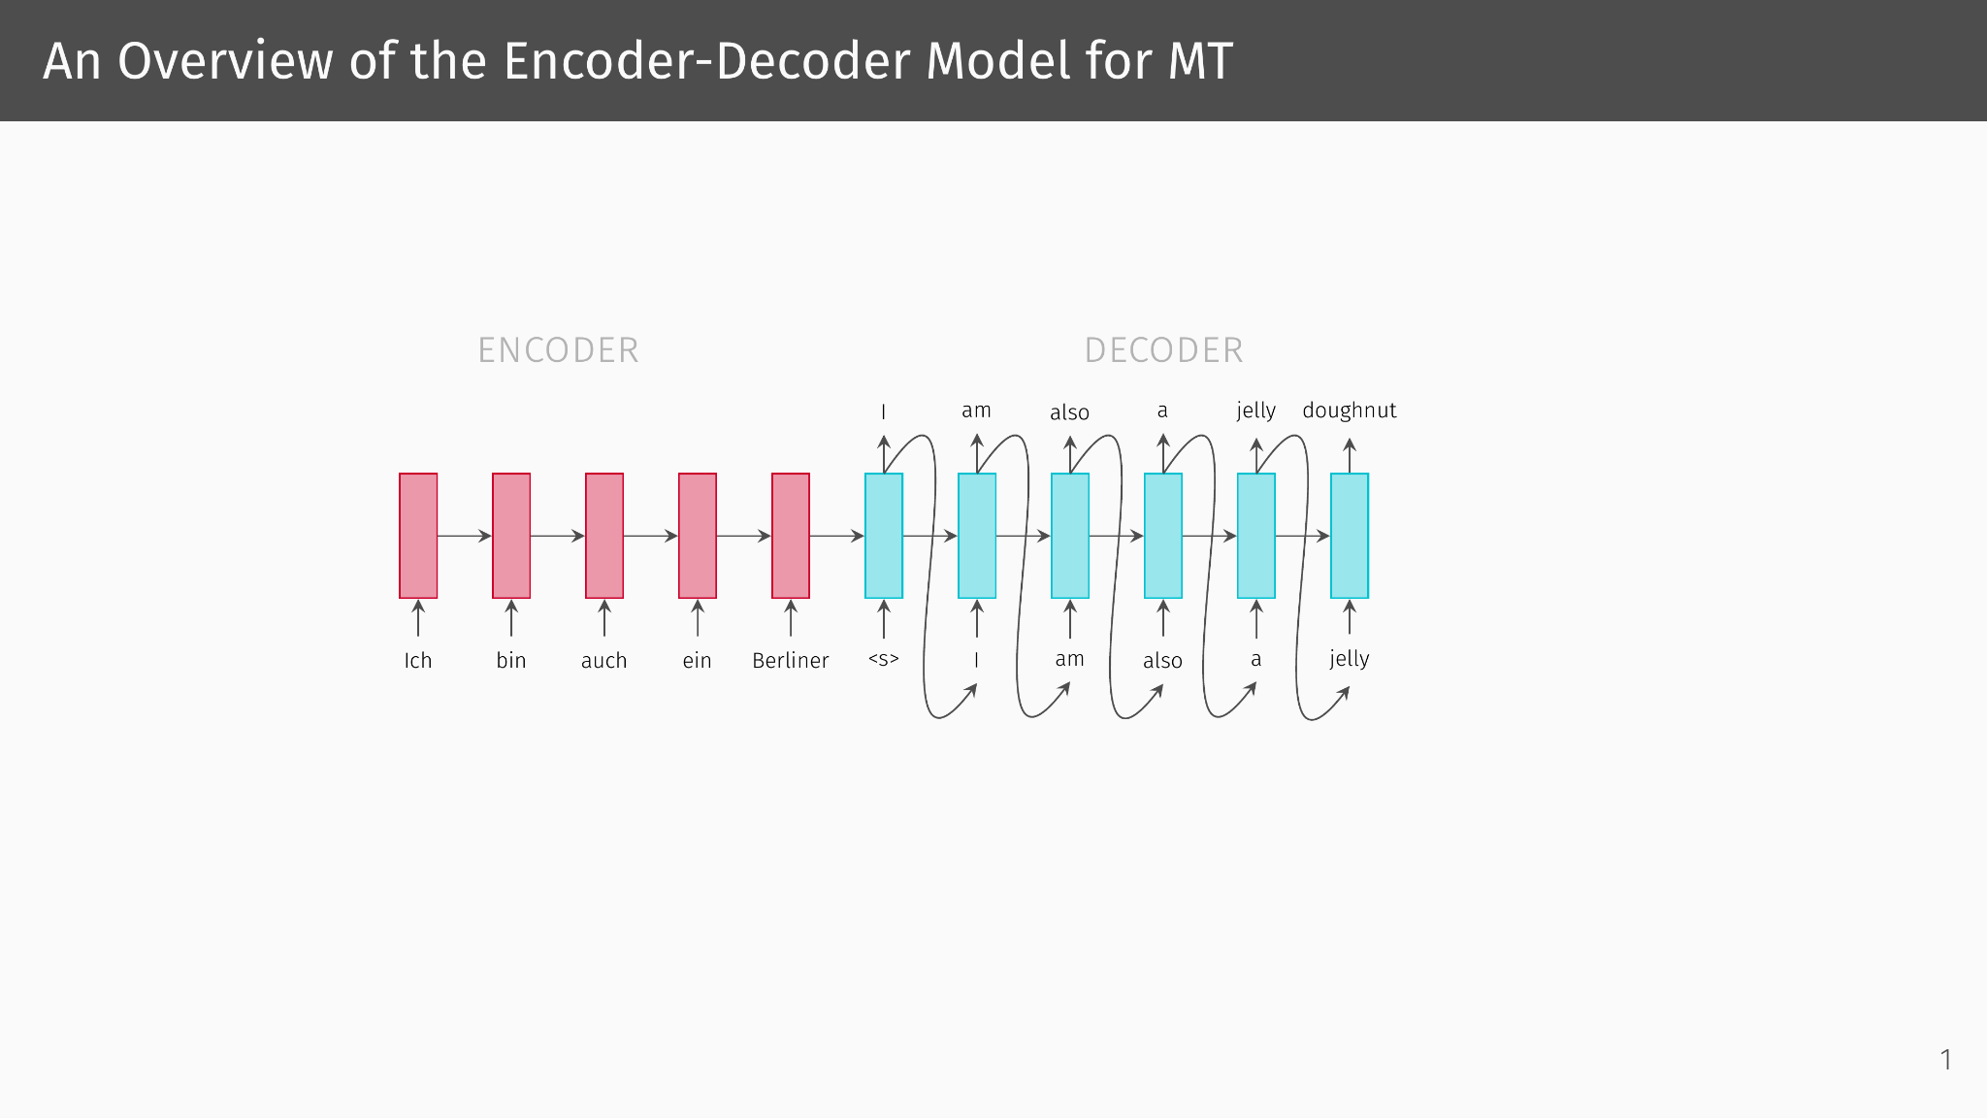

Slide 44
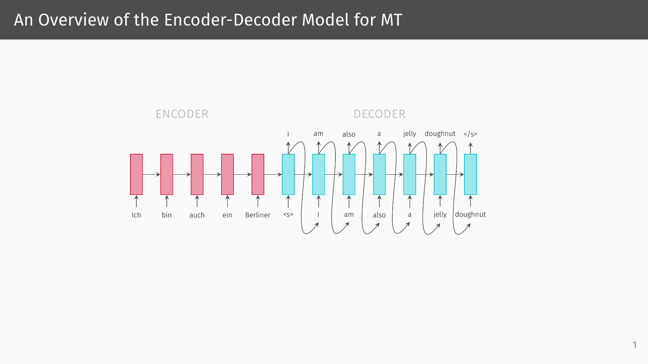

Slide 45
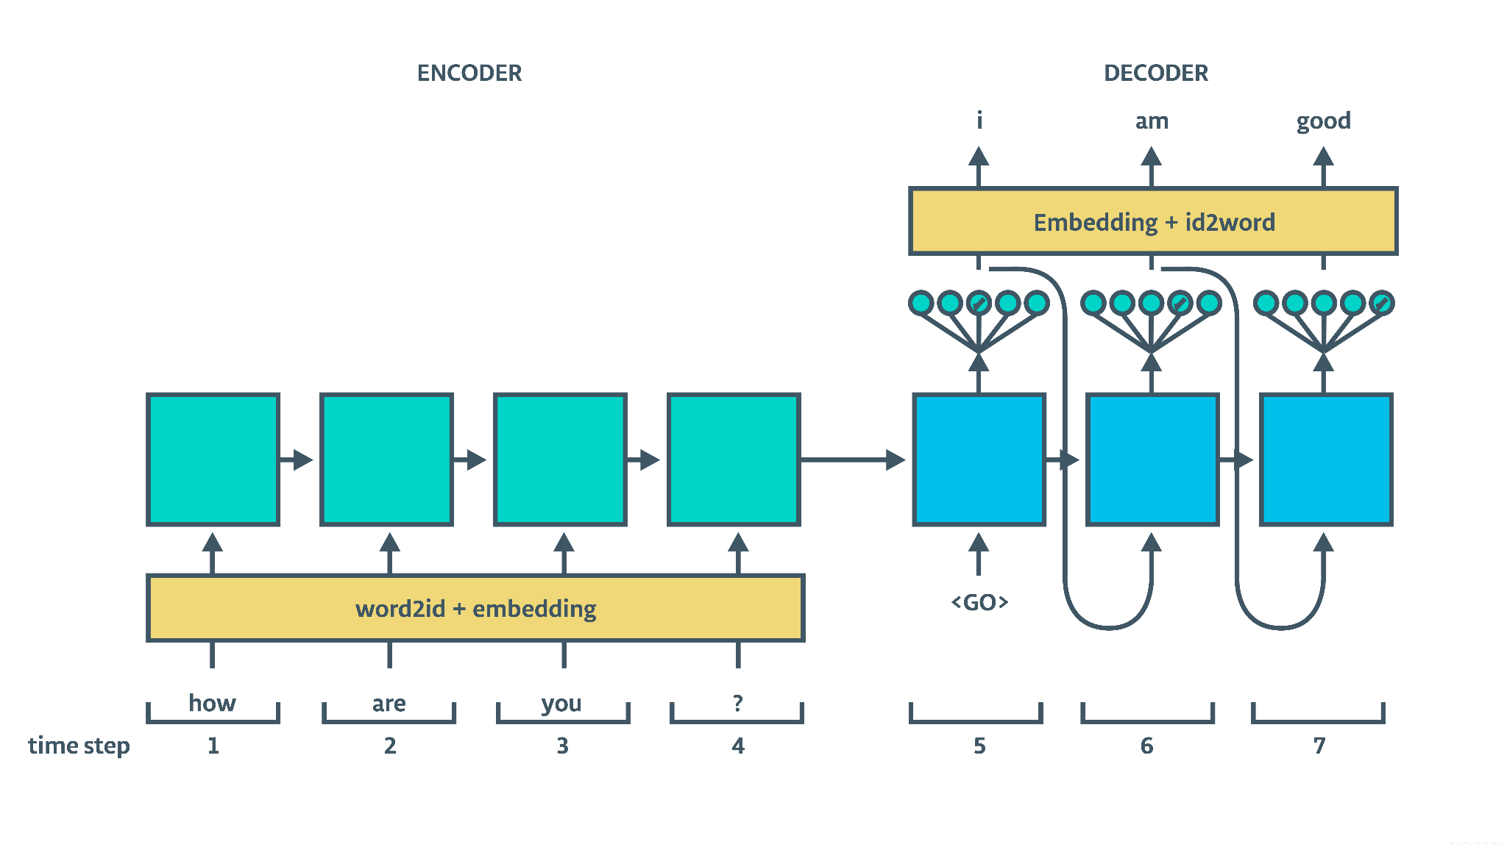
The Same Thing, in More Detail
Encode words as IDs
Map IDs to embeddings
Encode input, token-by-token, in hidden state
Pass hidden state and start token to decoder
At each step, pass output vector to softmax
Decode, map embeddings to IDs to tokens—the output

Slide 46
Attention and Self-Attention

Slide 47
Building intuition
Imagine I ask you to translate your favourite book

Slide 48
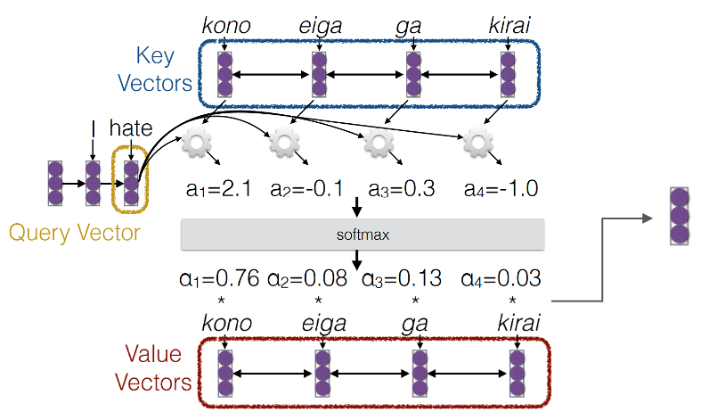
Attention Illustrated: RNN
The illustration shows an encoder-decoder model in a state where it has encoded the Japanese sentence, “Kono eiga ga kirai” and has decoded the first two words of the English translation, “I hate”.
In the illustration, the word “hate” is the query. It is being compared to each of the four Japanese words (keys). We will show the math later.
“Hate” has the highest attention to “kono” (this), indicating that the next English word might be “this”.
Explanation of the Japanese sentence:
Kono (this) eiga (movie) ga (NOM) kirai (hate)

Slide 49
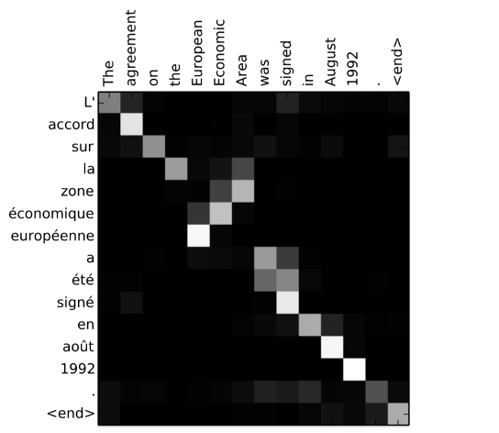
The Stronger the Relationship, the Stronger the Attention
Attention is a way of establish many-to-many relationships among words in an encoder-decoder model.
The weight matrices by which key, query, and value matrices are obtained from words are trained so that keys will be most similar to queries when their associated words are most related to each other.

Slide 50
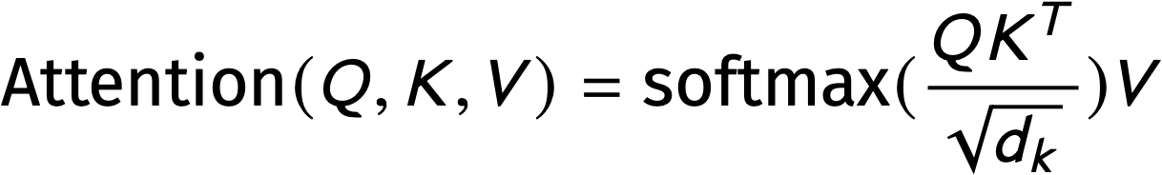
Self-Attention is a Special Kind of Attention in which Words Can Attend to Words in the Same Sequence
Self-attention, as we will define it, is the value matrix V weighted by the softmax of the dot product of the query matrix Q and the transpose of the key matrix K (divided by the square root of the dimensions of the key vector).
Intuition: the stronger the relationship of an item at position j is to that at position i, the larger the dot product of the query vector for i and the key vector for j. The larger this dot product, the more the value vector at position j will contribute to the output.

Slide 51
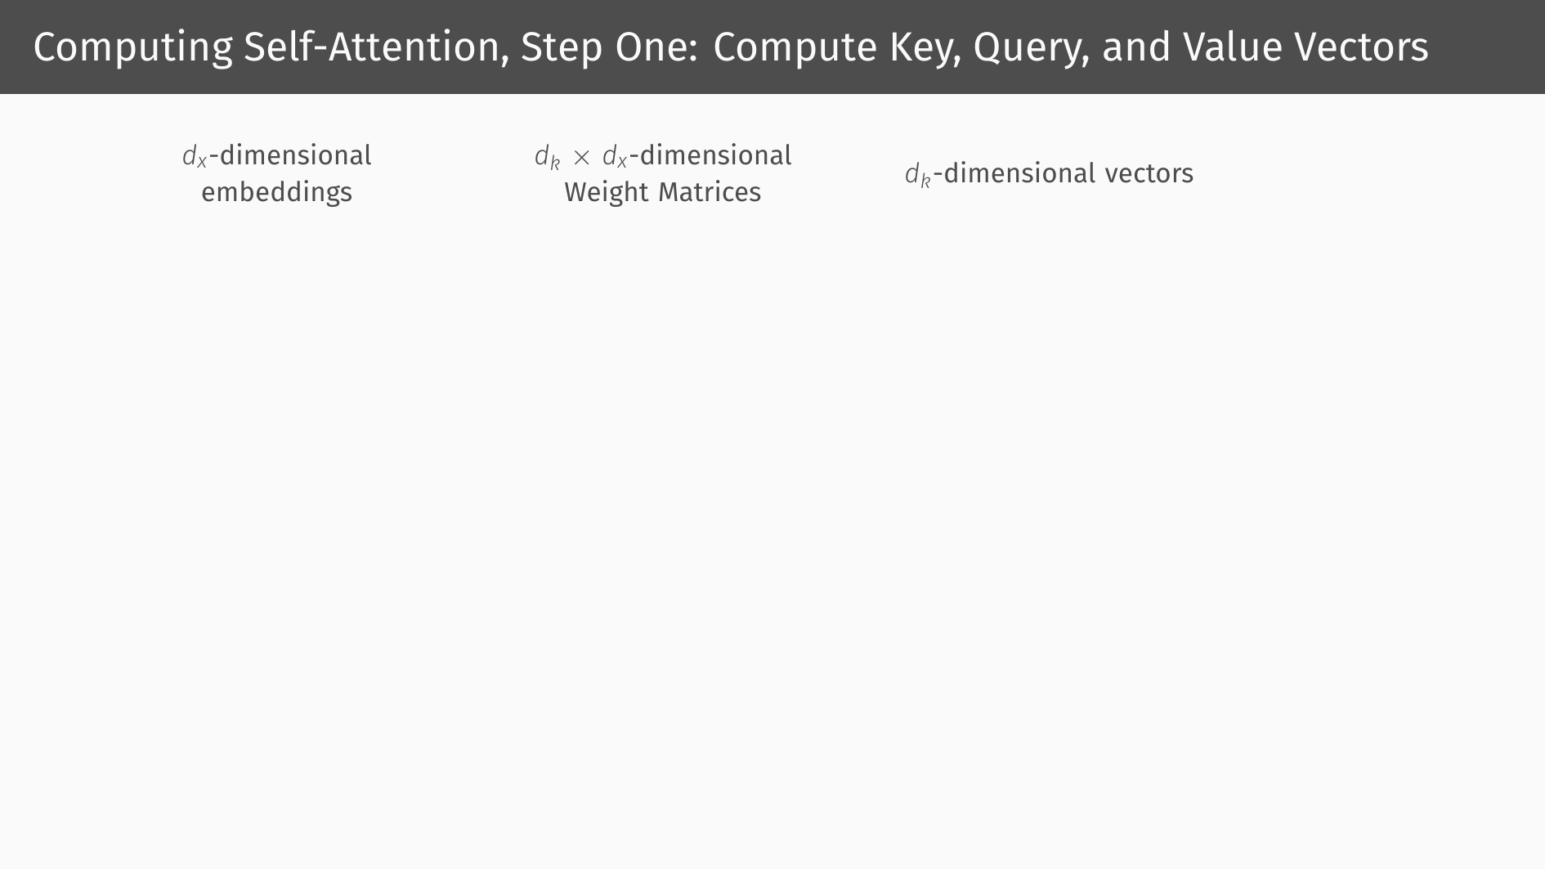

Slide 52
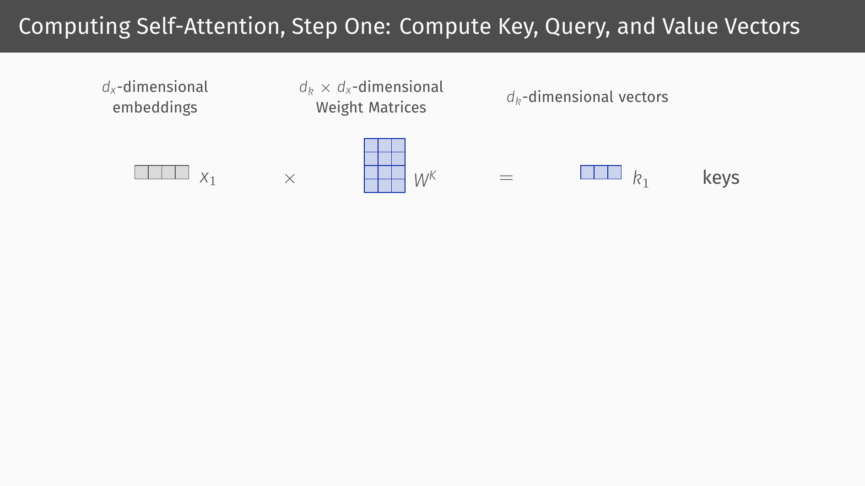

Slide 53
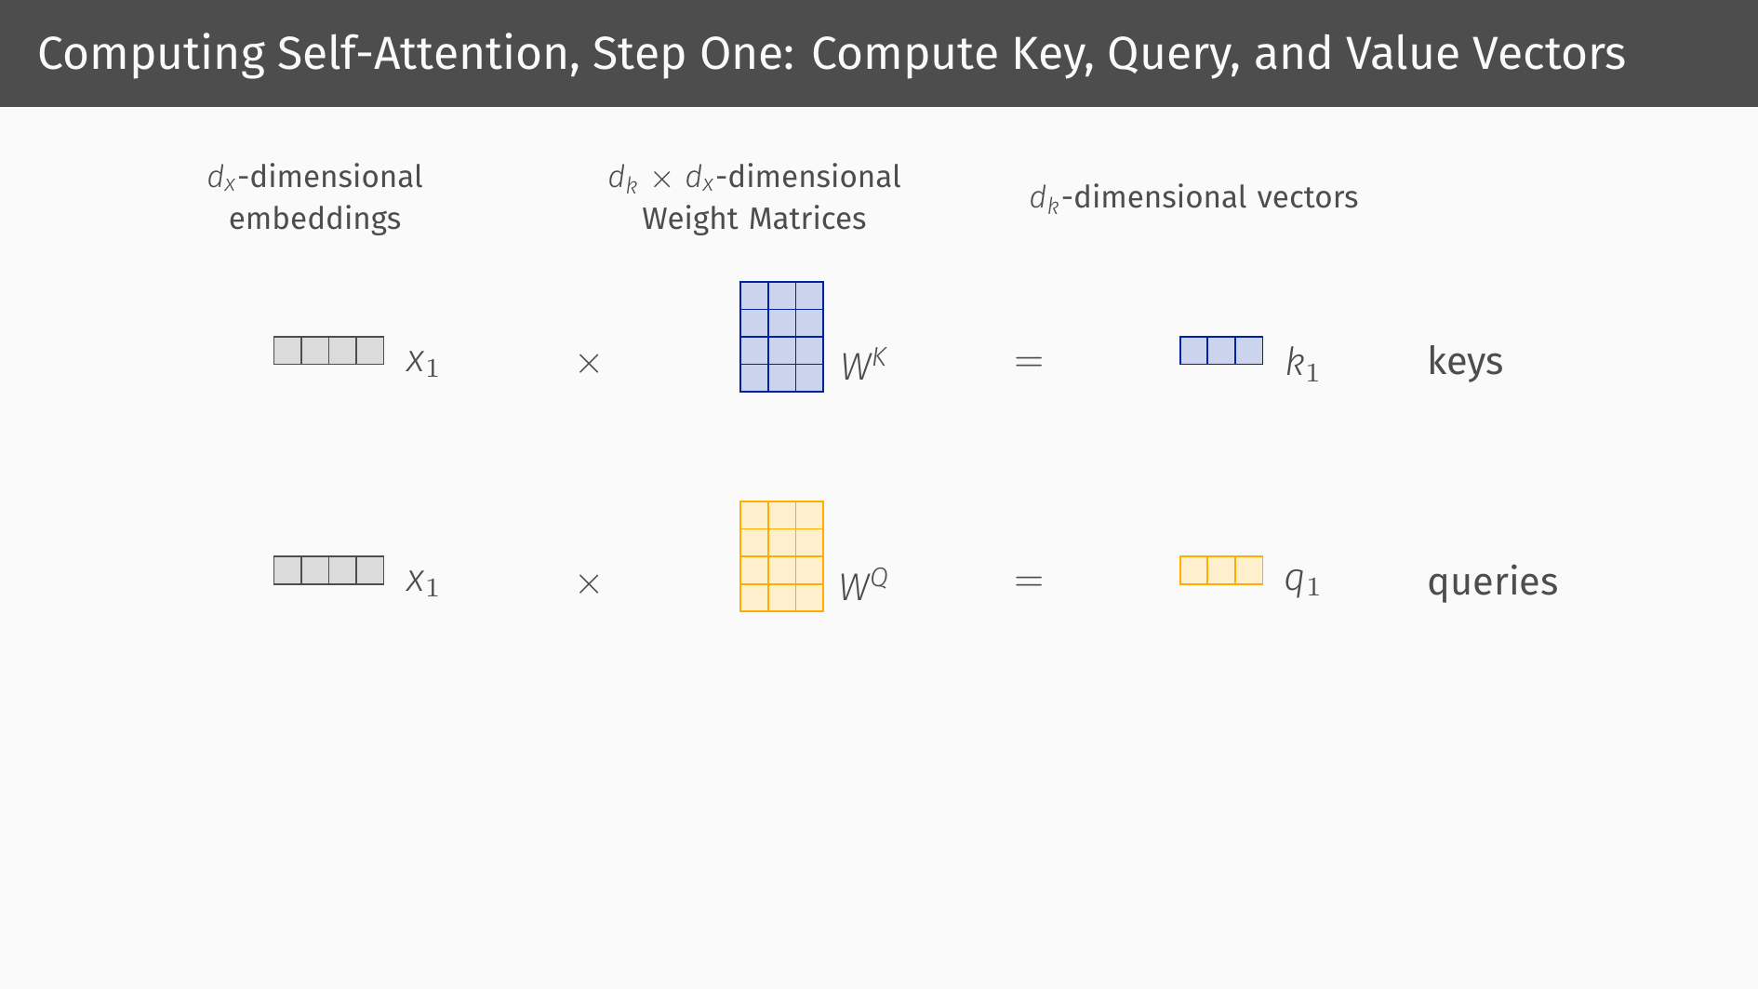

Slide 54
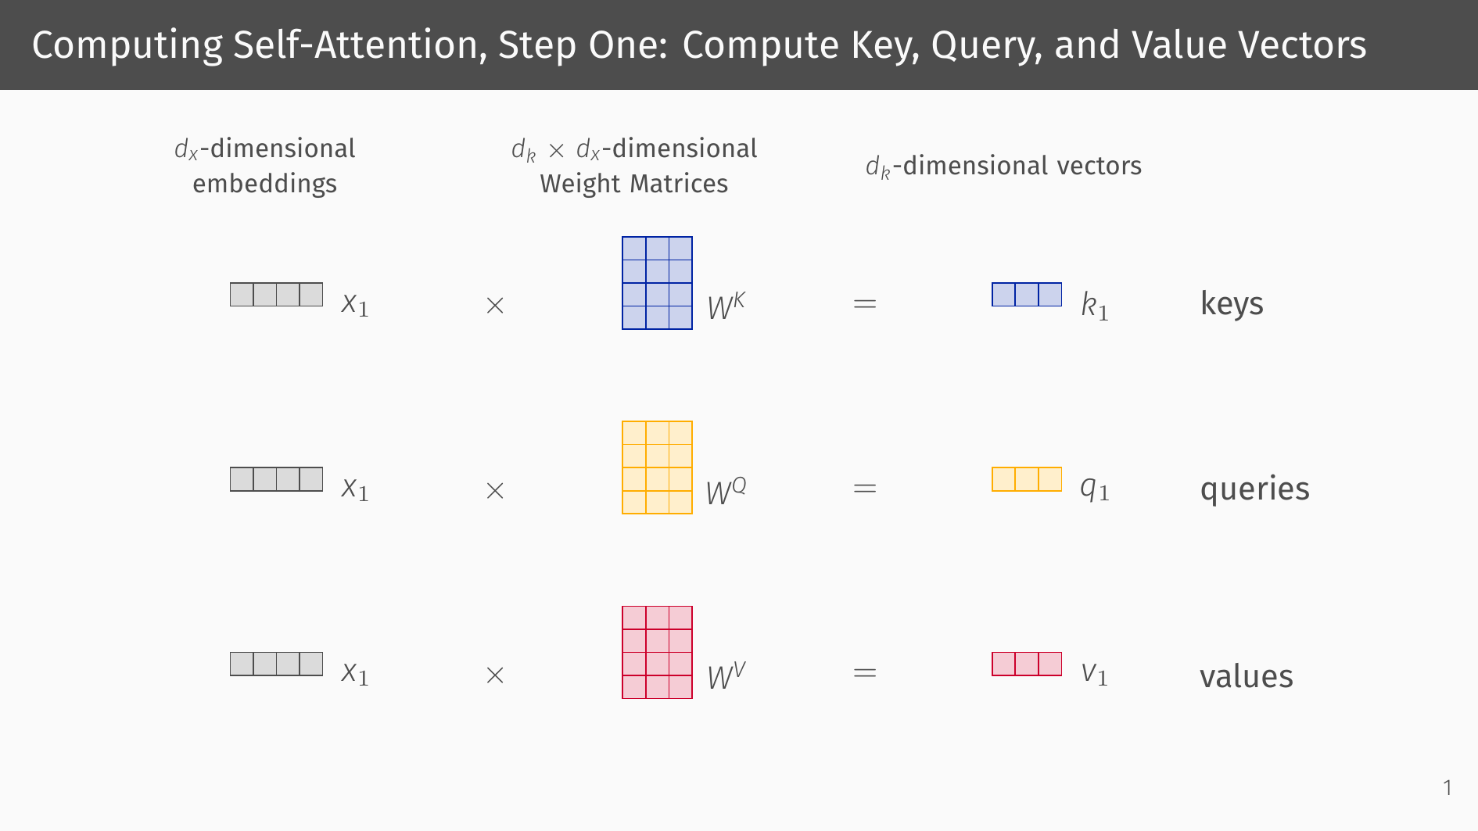

Slide 55
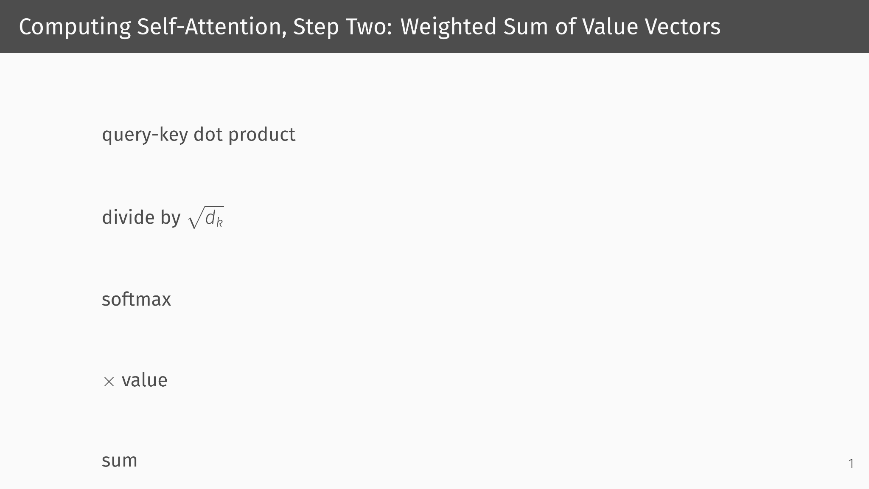

Slide 56
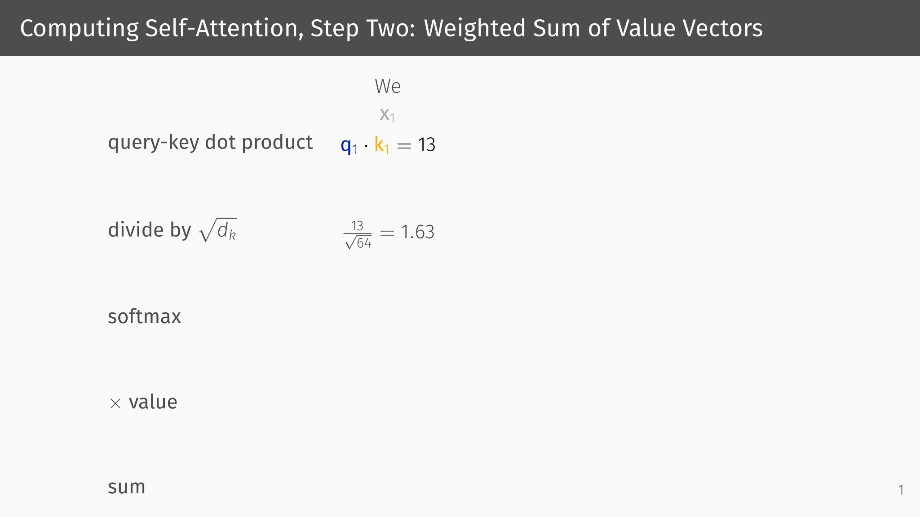

Slide 57
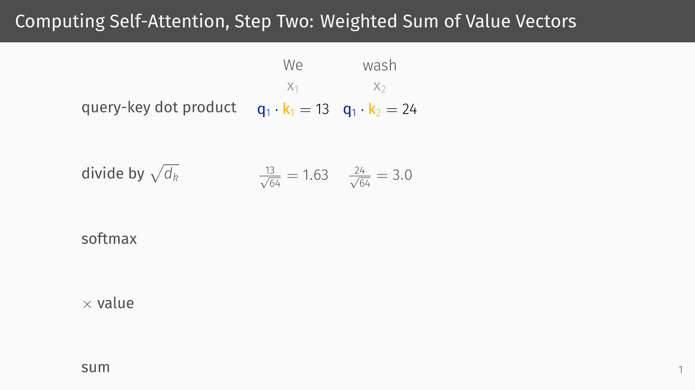

Slide 58
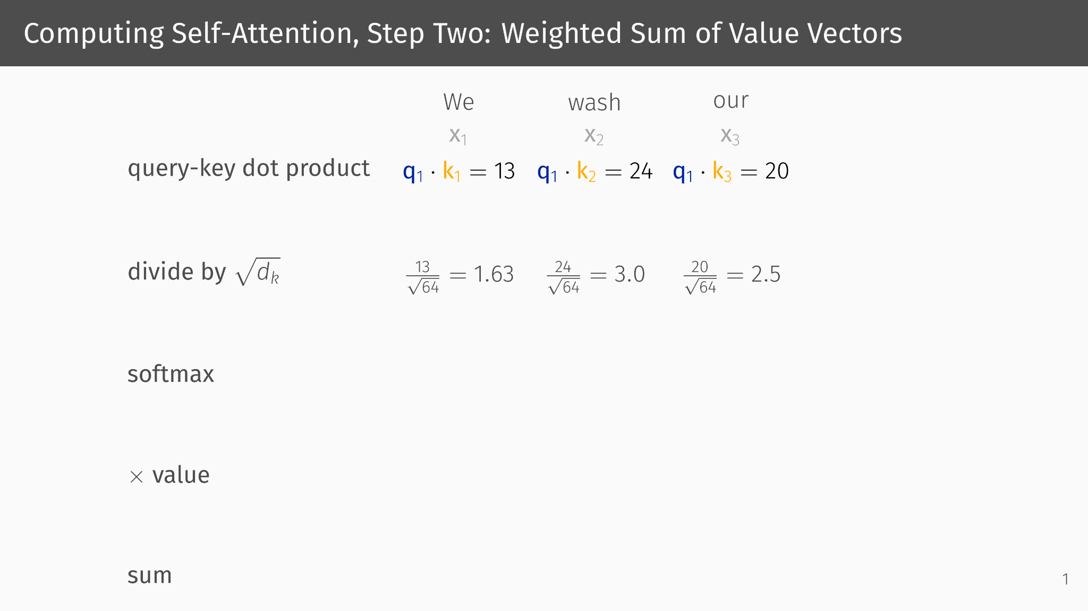

Slide 59
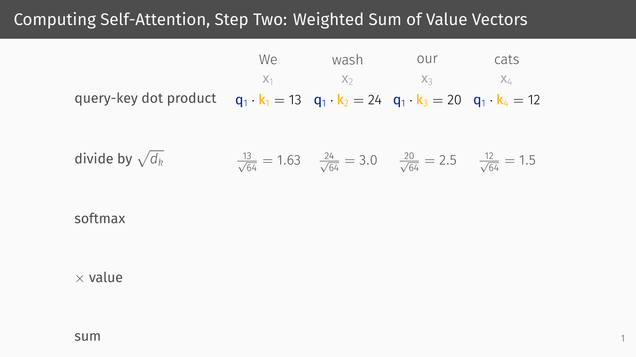

Slide 60
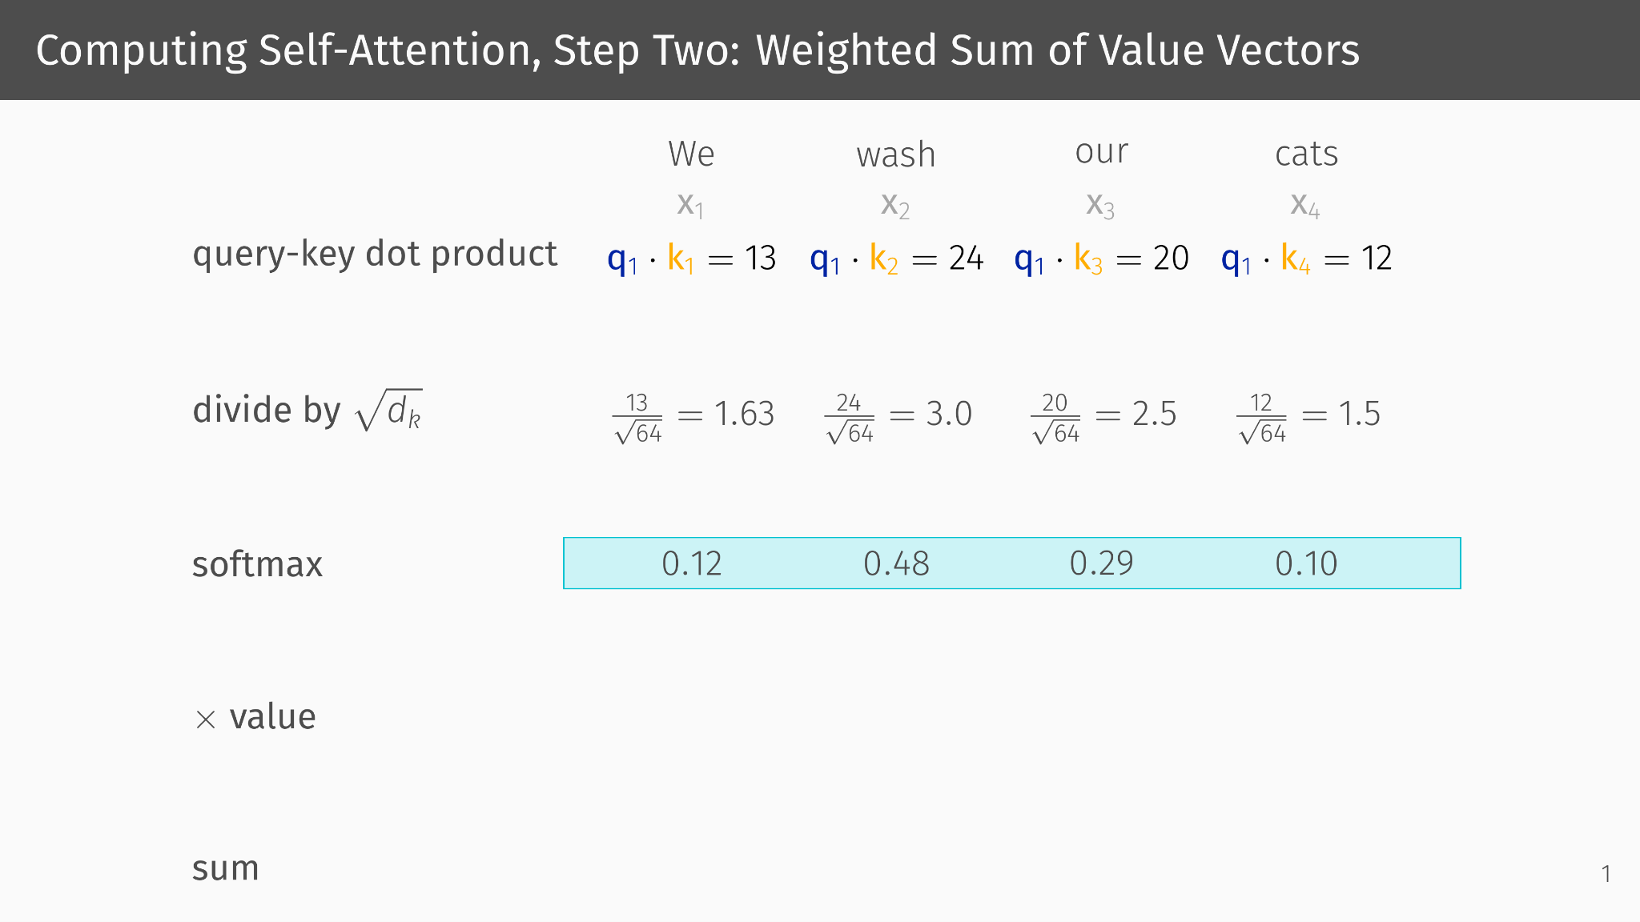

Slide 61
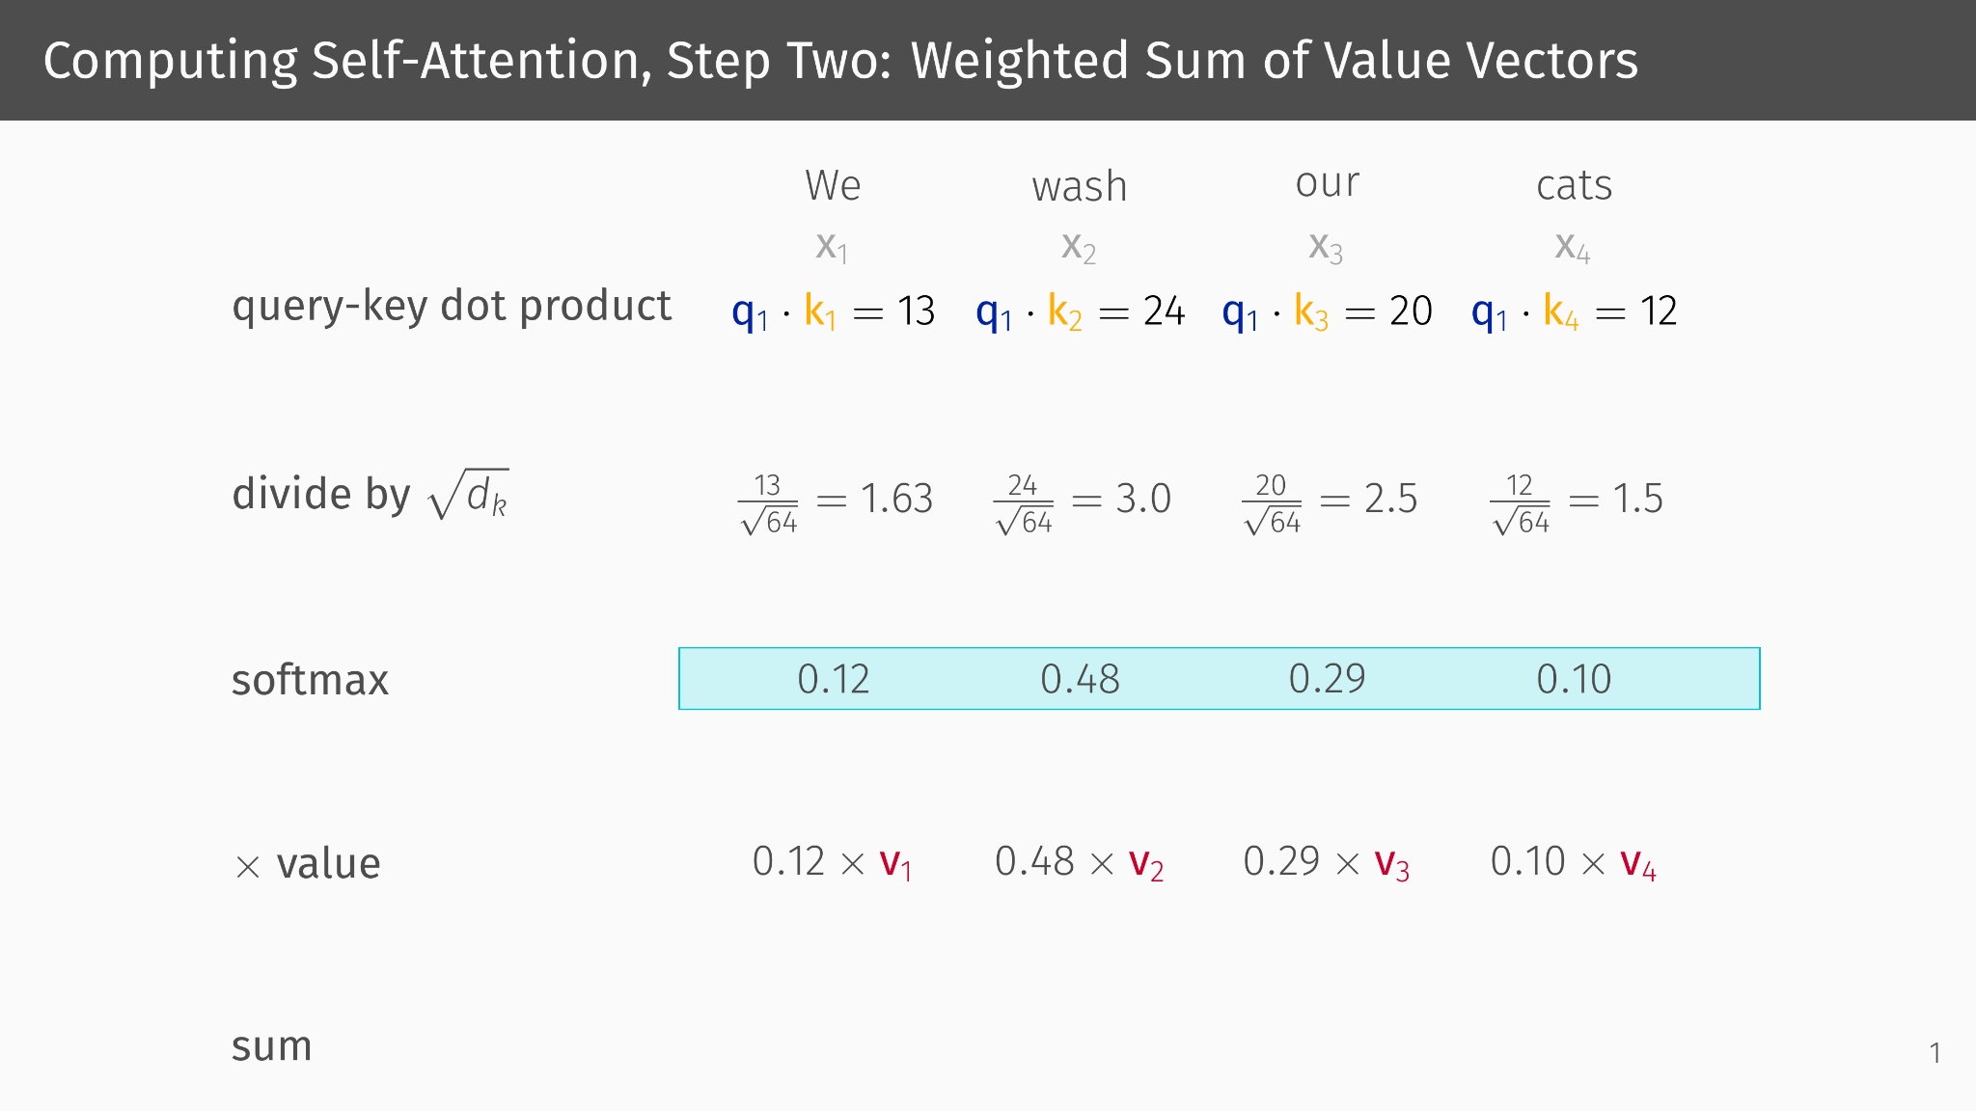

Slide 62
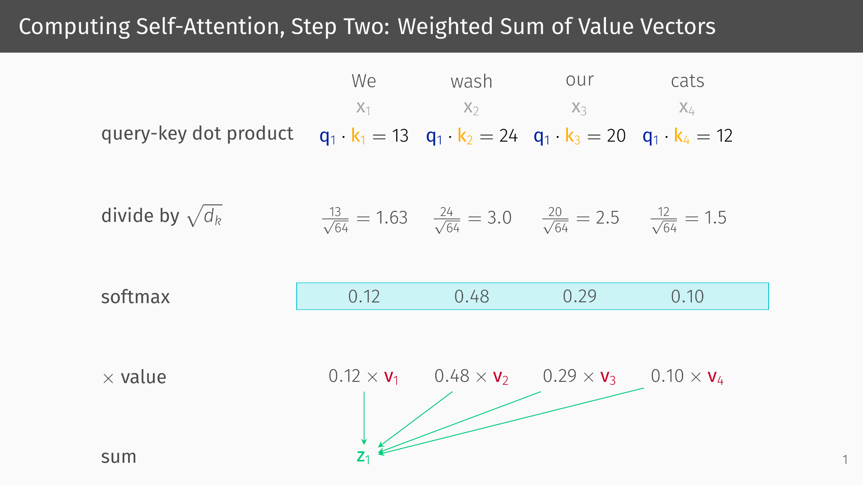

Slide 63
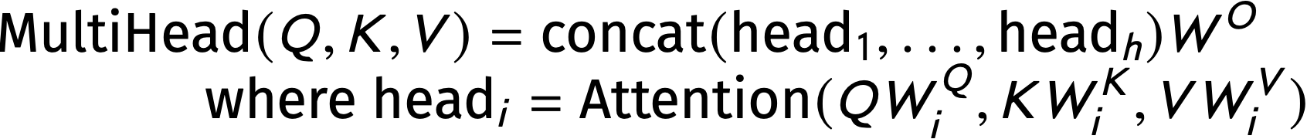
Multihead Self-Attention
In multihead attention, there are multiple attention “heads,” each with their own weight matrices W^{Q}_{i}, W^{K}_{i}, and W^{V}_{i}. MultiHead is the product of the output weight matrix W^{O} and the concatenation of the outputs from the h heads.

Slide 64
The Linguistic Intuition behind Multi-Head Attention
There are many heads in an encoder or decoder (as we will discuss when we introduce the Transformer)
There are also many relationships in language
Between verbs and their subjects/objects I passed the test with flying colors.
Between pronouns and their antecedents (the phrases they stand in for) Lori delivered the lecture on Thursday that she prepared Tuesday morning.
And so on…
Multiple heads allow a model to have separate weight matrices for each kind of relationship.
W^{K} and W^{Q},matrices are trained so that positions (e.g., words) that are in a particular relationship will have a strong association (the resulting k and q vectors will have a large dot product)
We will talk more about this in a moment.

Slide 65
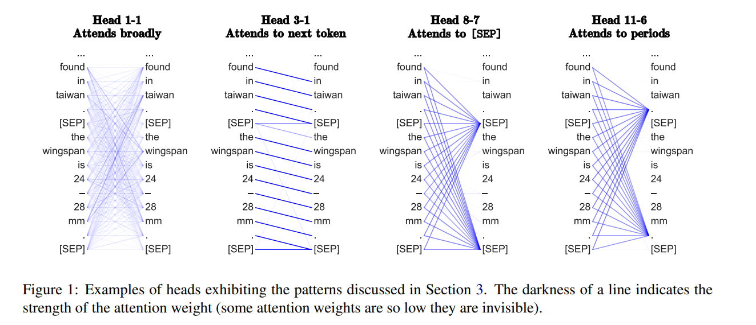
What are the heads looking at?

Slide 66
Transformers

Slide 67
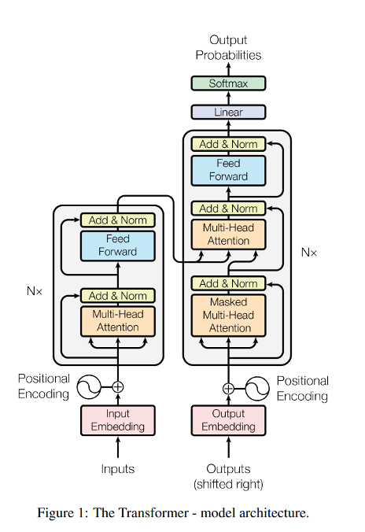
The Transformer Architecture: Encoders
Transformers consist of
Stack of N encoders
Stack of N decoders
Each encoder has
A multi-head attention layer
A feed-forward neural net
After each of these, there is an additive normalization step (which keeps the changes from from the preceding layers from being too large).

Slide 68
The Transformer Architecture: Decoders
The decoders consist of a masked multi-head attention layer, a multi-head attention layer, and a feed-forward neural net (with additive normalization).
The outputs pass through a linear layer and softmax.
Outputs from the encoder are inputs to the multi-headed attention layer.

Slide 69
Advantages and Disadvantages of Transformers
Transformers have several advantages over Simple RNNs and LSTMs
No issue with directionality—all positions are connected to all other positions via attention
No vanishing gradients—long distance relationships are, in principle, indistinguishable from other relationships
Parallelizable—attention can be computed in parallel (no recurrence)
They have one particular disadvantage:
Lots of parameters—lots of encoders/decoders with lots of heads, each with W^{Q}, W^{K}, and W^{V}, each with lots of dimensions (not to speak of the FFNNs). They take lots of data to train!

Slide 70
Transformers Applied to MT

Slide 71
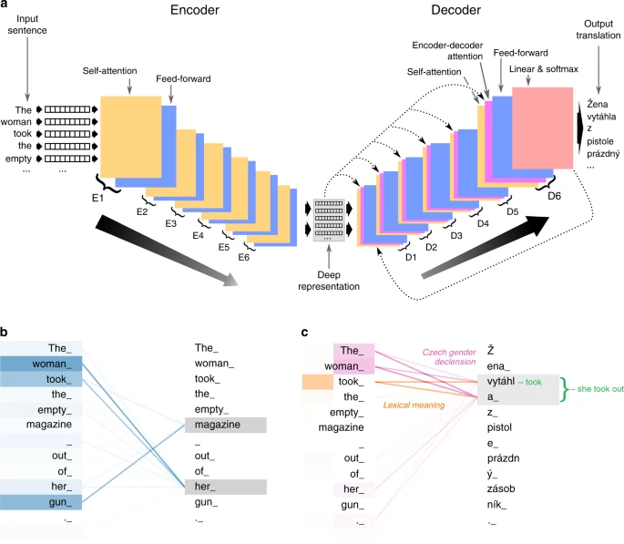
One Approach to MT using Transformers
Inputs (tokens from source sentence) are embedded (not shown: positional encoding) and fed to the first encoder
Each encoder feeds its output to the subsequent encoder
From last encoder: “deep representation” (tensor)
Each decoder receives input from:
preceding decoder (after D1)
Deep representation
Last encoder feeds output to linear & softmax layer, resulting in a probability distribution over output translations
Feedback from last layer to first decoder

Slide 72
Teacher Forcing

Slide 73
Why Teacher Forcing
Alien
What if the output of the decoder is wrong?
Error propagates in consecutive timesteps of the decoder
Increases the time taken for model training to reach acceptable performance

Slide 74
How to Tackle this? Teacher Forcing!
Based of a weighted coin toss, we feed the actual previous target outputs (or expected correct inputs) as inputs to the decoder at every timestep, rather than previous output of the decoder.
As the model learns, it will generate the right target outputs as expected
When do you use teacher enforcing?
To be implemented in HW6

Slide 75
Questions?

Slide 76
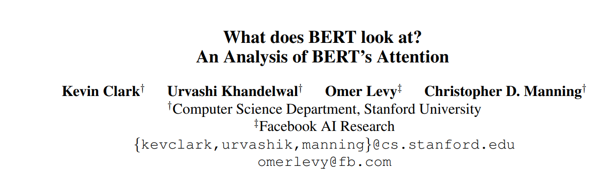

Slide 77
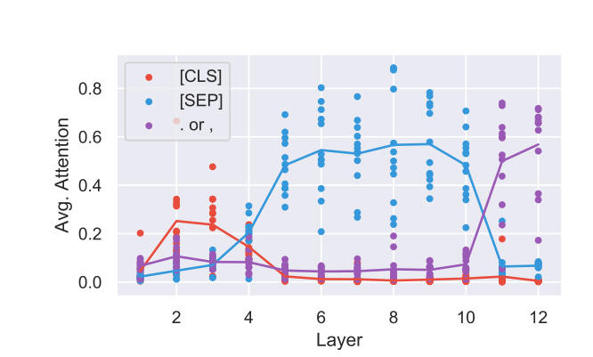
Heads in different layers are looking at different things.

Slide 78
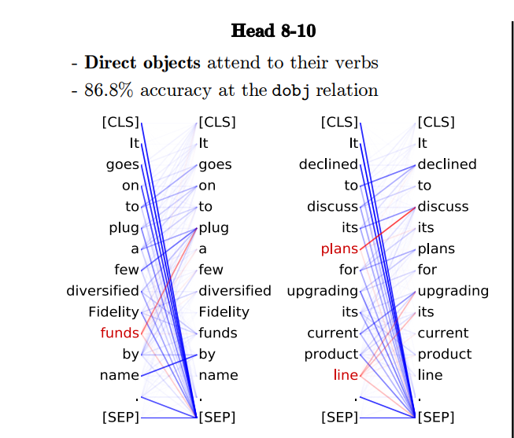
Train a classifier to identify direct objects (dobj) based on attention scores.
In order to see if the classifier is accurate, compare it to a dependency parse (preview for next week!)
1 it subj 2
2 goes root
3 on fixed 2
4 to mark 5
5 plug xcomp 2
6 a det 10
7 few nmod 10
8 diversified nmod 10
9 fidelity compound 10
10 funds dobj 5
11 by mark 12
12 name oblique 5

Slide 79
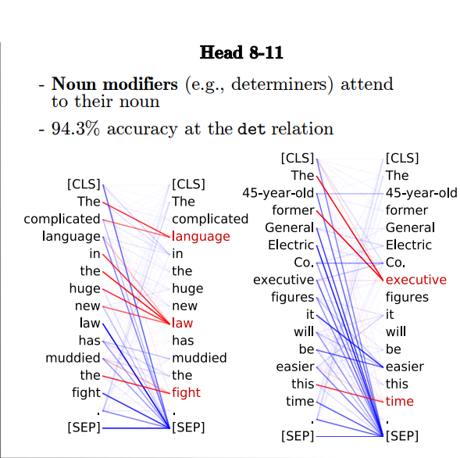
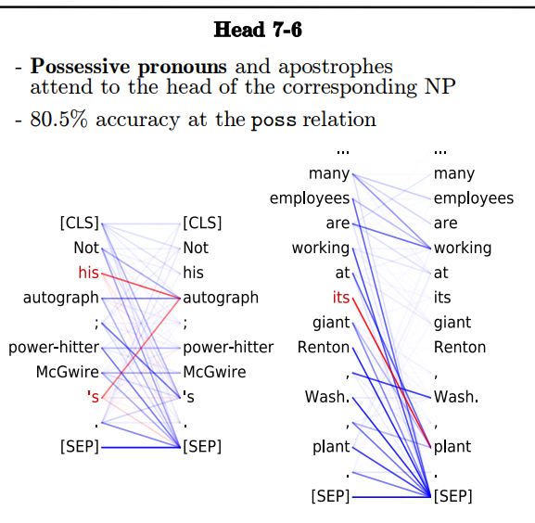

Slide 80
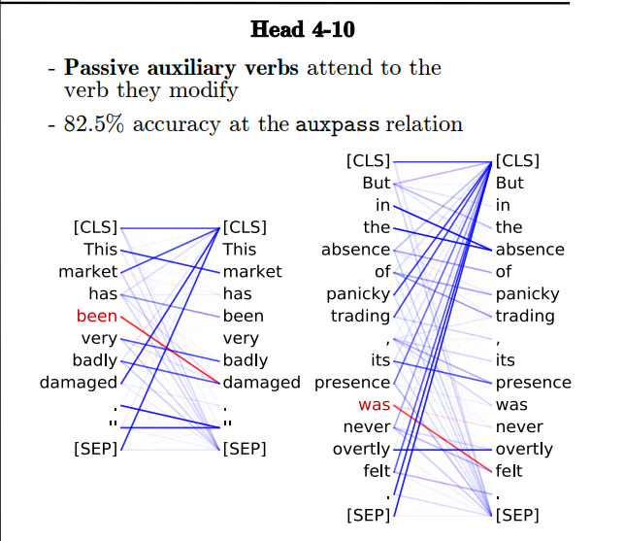

Slide 81
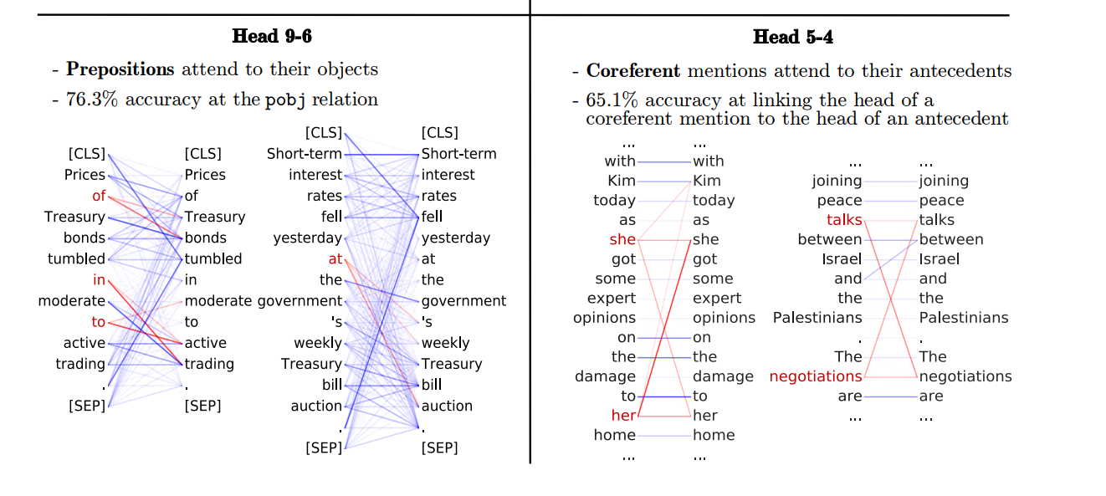

Slide 82
Issues in Bertology
The study of what Transformer models are capable of is often called “Bertology” after BERT. It raises a number of fundamental issues:
Interpretability of models
Can grammar be learned without explicitly training on it?
Is grammar primary or epiphenomenal

